Slide 1

Advanced Programming CMP 102
Dr. Perihan PEHLİVANOĞLU
Biruni Univarsity
Department of Computer Engineering 2023
Spring

Slide 2
Course Plan
Introduction - Functions (Recursive functions) Arrays, ArrayList, Vector
Collections (List, Queue, Stack, Set, Map, Tree)
Streams, Files
Generics and Exceptions
Midterm Exam

Slide 3
Course Plan
Visual Programming Fundamentals Designing a Form Controls and Forms Properties of Components and Events Final Exam

Slide 4

Last Lecture
Setup JavaFX.
Introduction to JavaFX.

Slide 5
Introduction
In this lecture, you will visual programming fundamentals.

Slide 6
VISUAL PROGRAMMING

Slide 7
JavaFX Program Structure
In this lecture, you will learn the basics of JavaFX for visual programming in Java.
Coding made easy with IntelliJ IDEA.
Eclipse is a little more challenging.

Slide 8
IntelliJ and Java FX

Slide 9
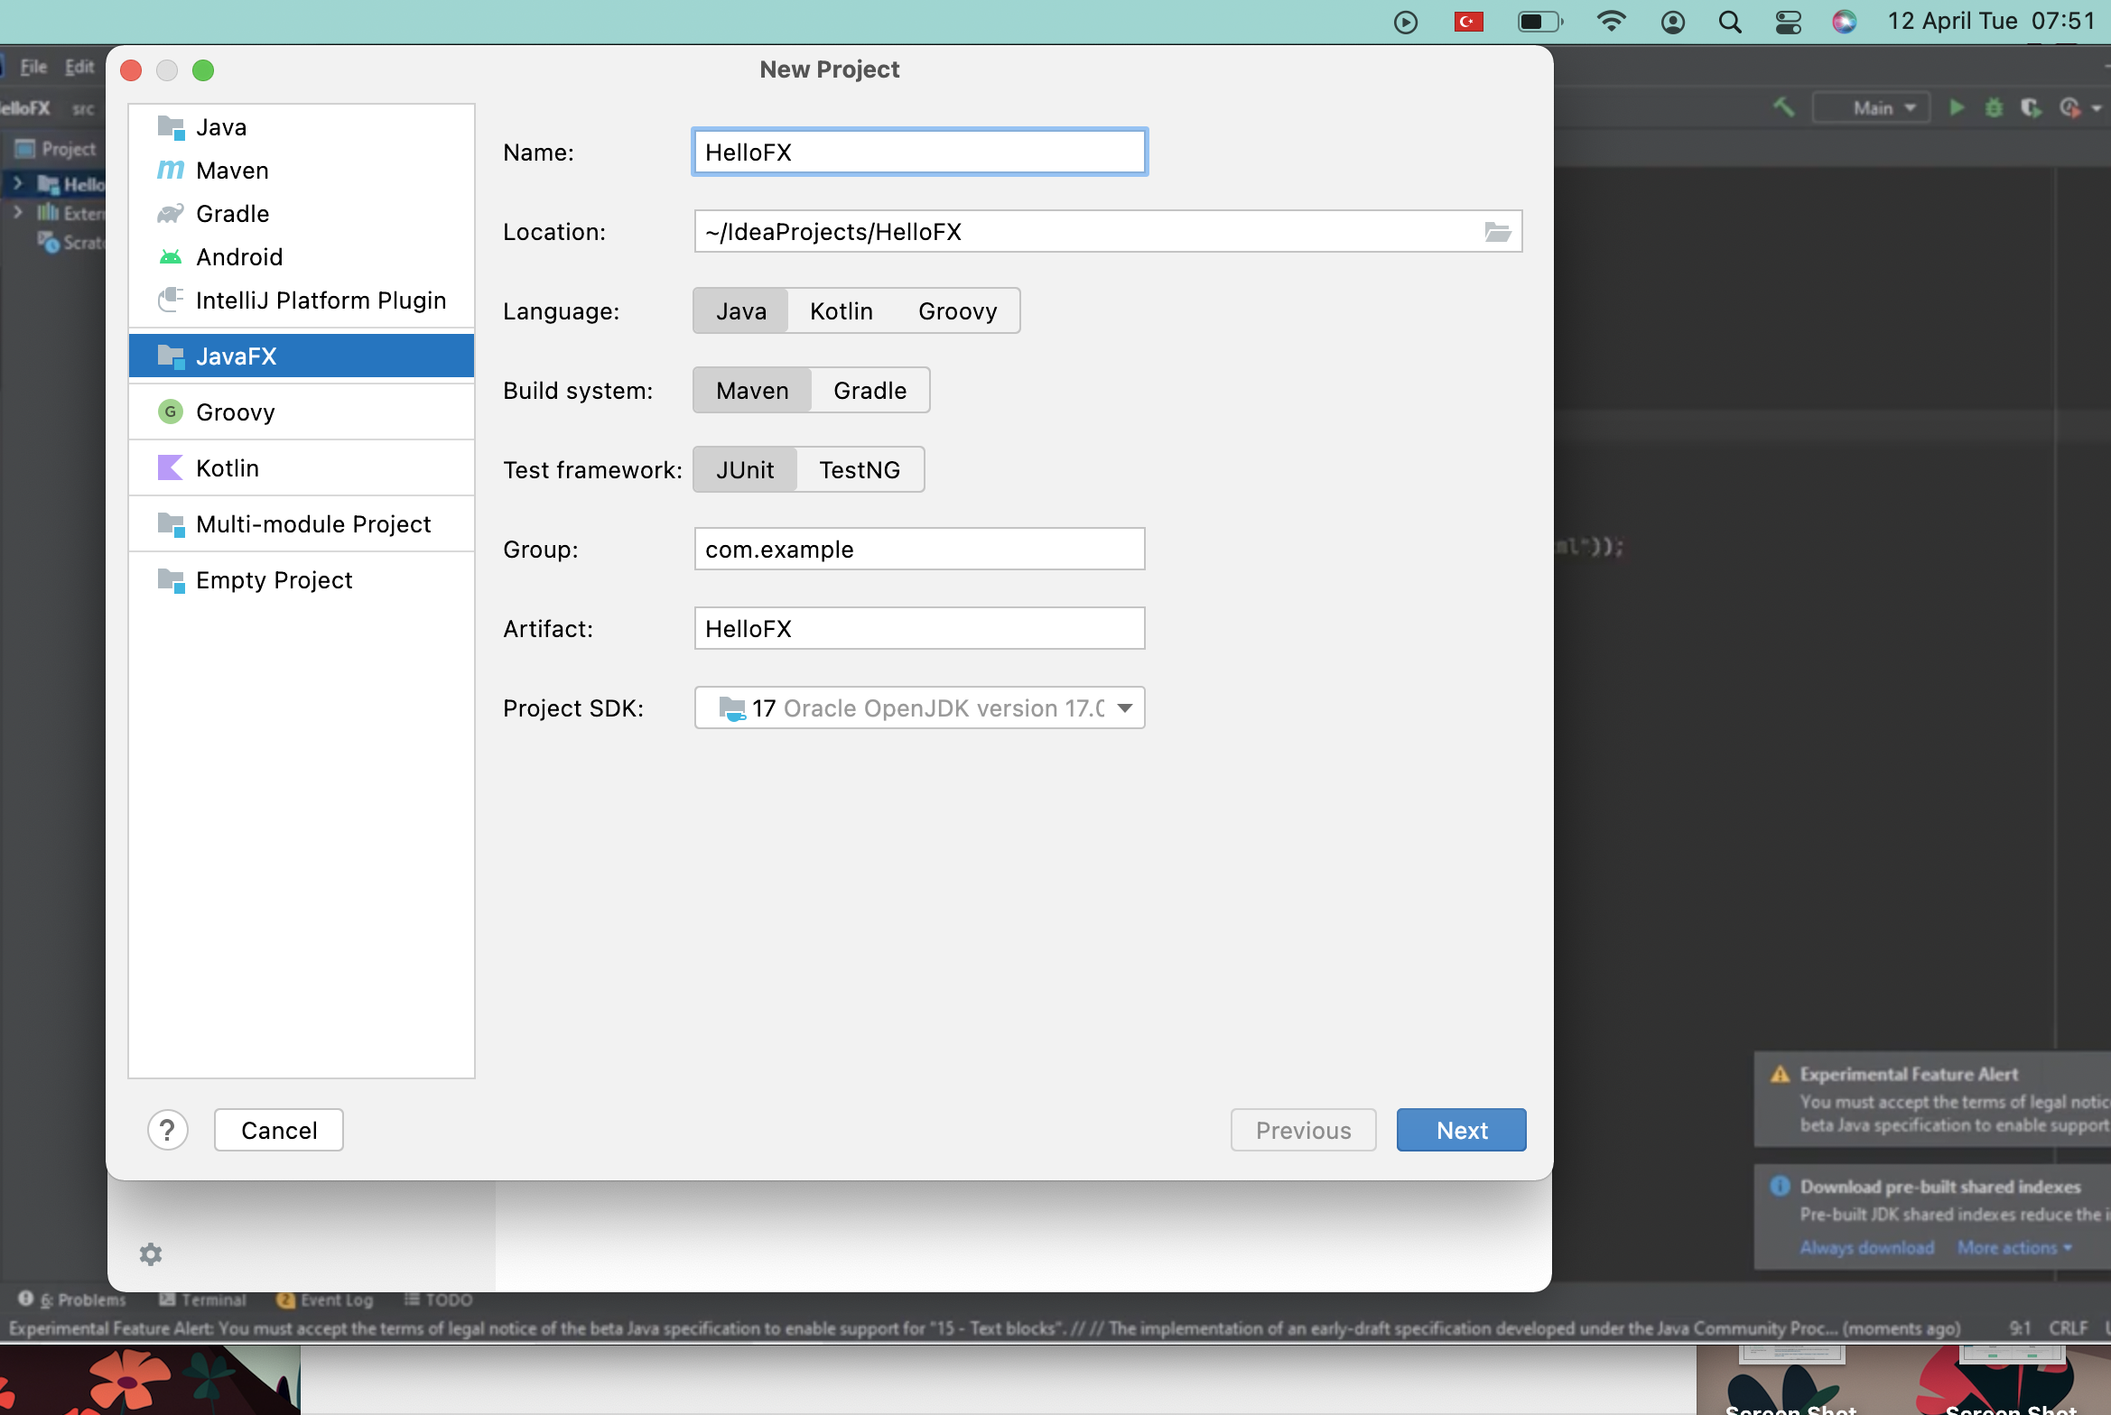
Installing JavaFX
With IntelliJ IDEA create a new Project.

Slide 10
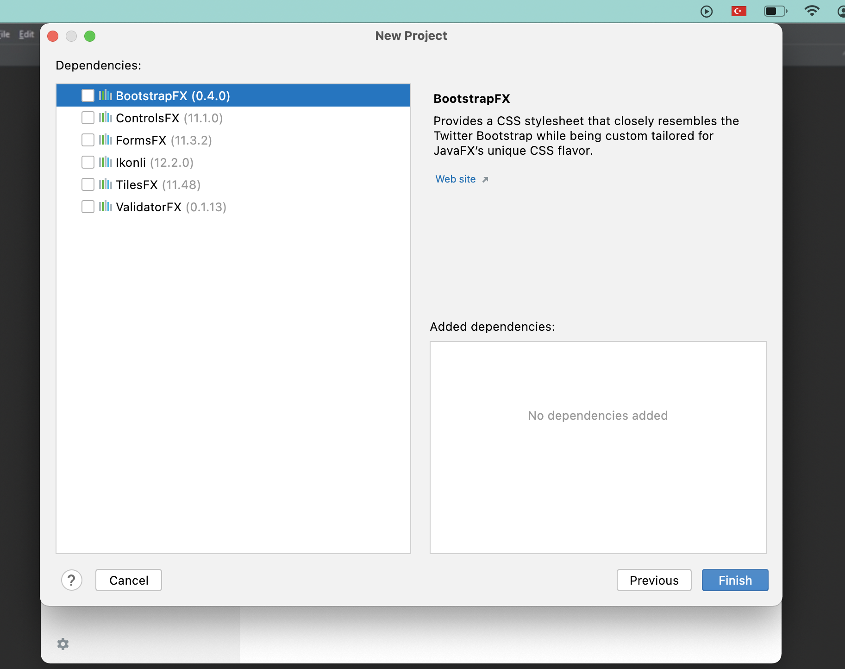
Installing JavaFX
IntelliJ IDEA

Slide 11
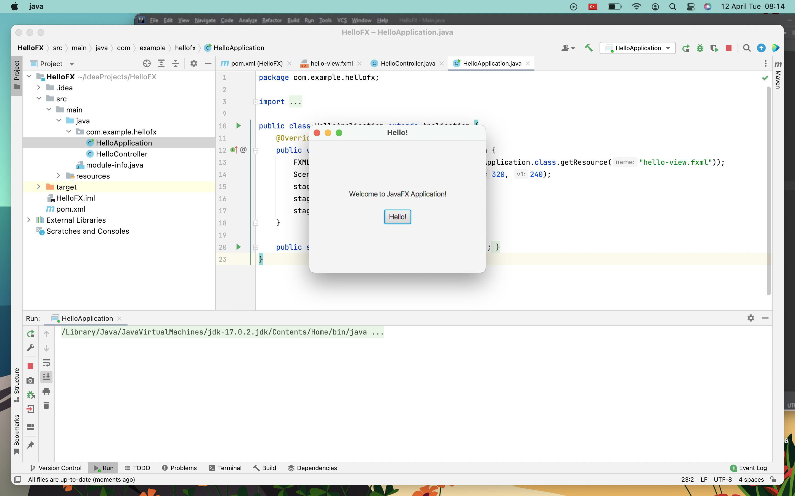
Installing JavaFX
Example.

Slide 12
JavaFX and Scene Builder

Slide 13
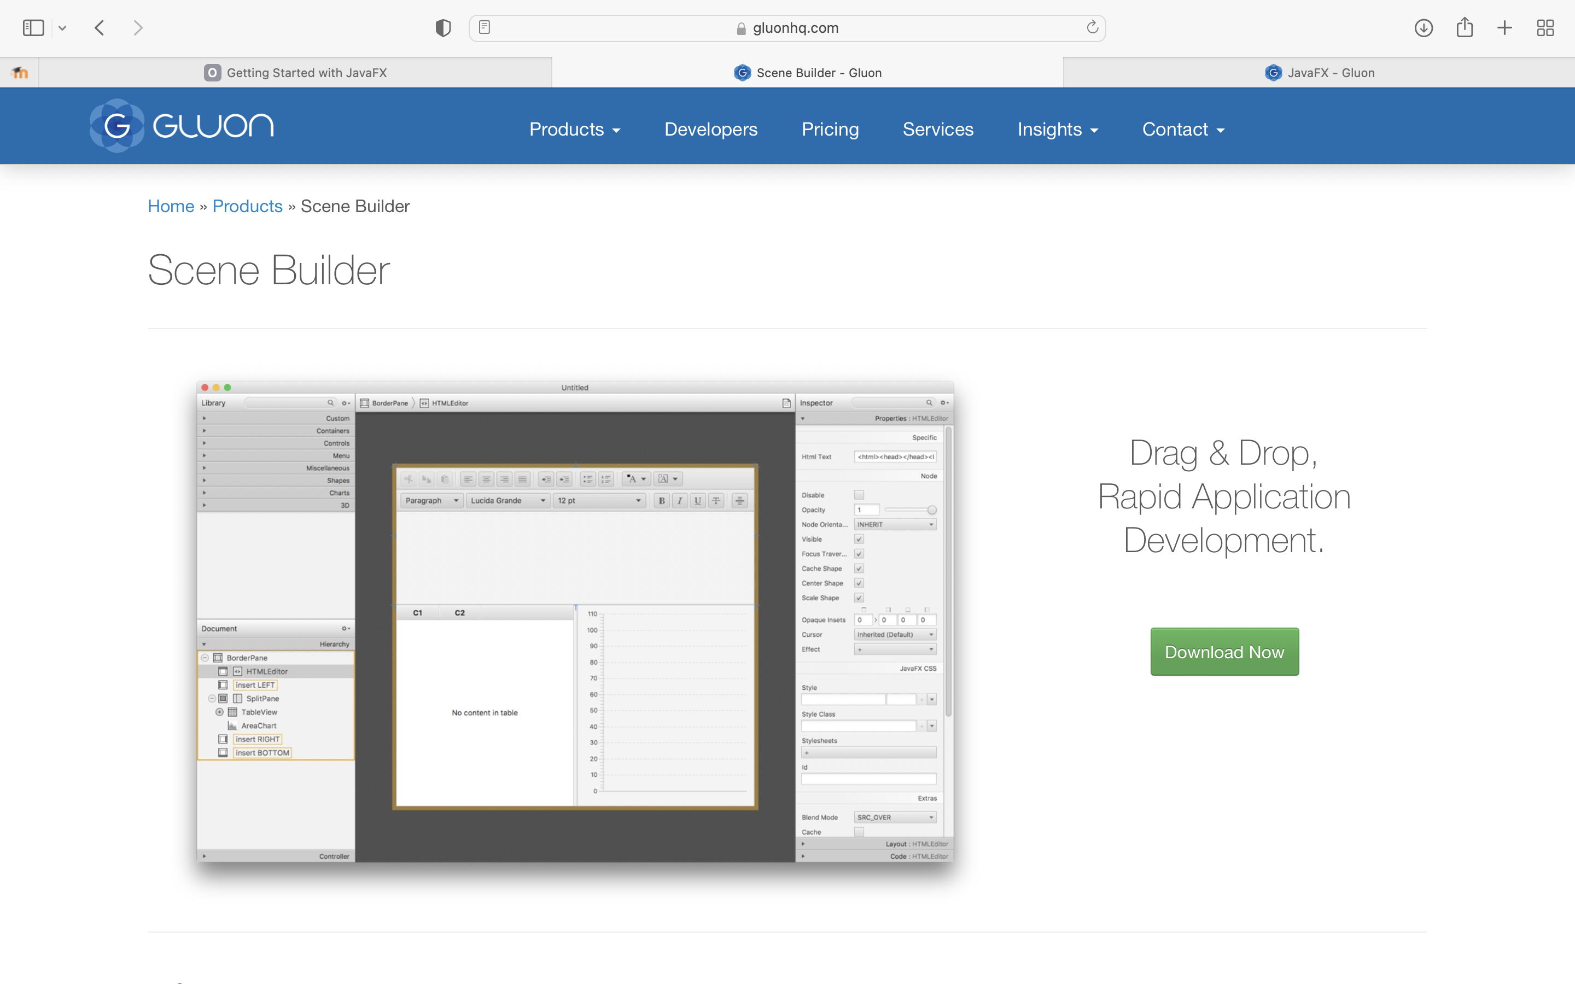
Installing JavaFX Scene Builder
Install JavaFX Scene Builder.

Slide 14
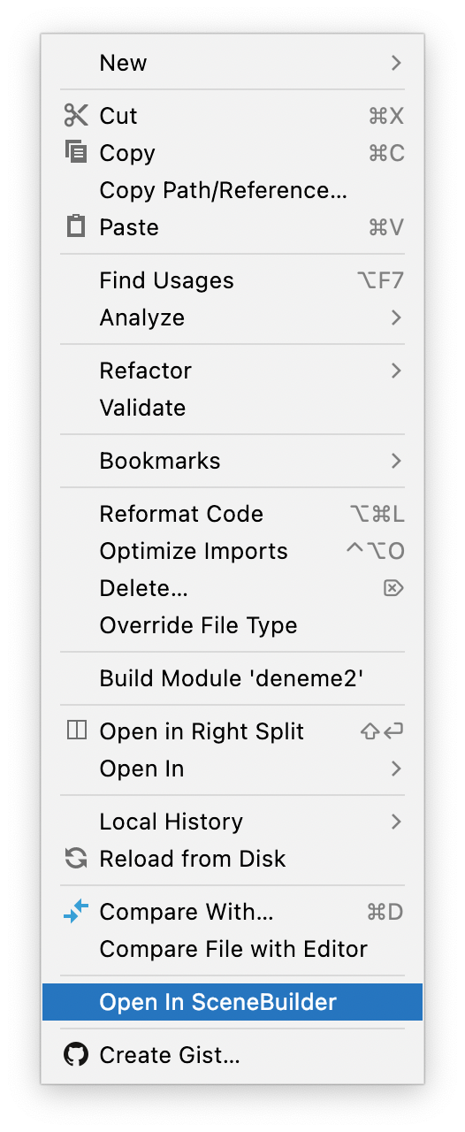
Installing JavaFX Scene Builder
Install JavaFX Scene Builder.

Slide 15
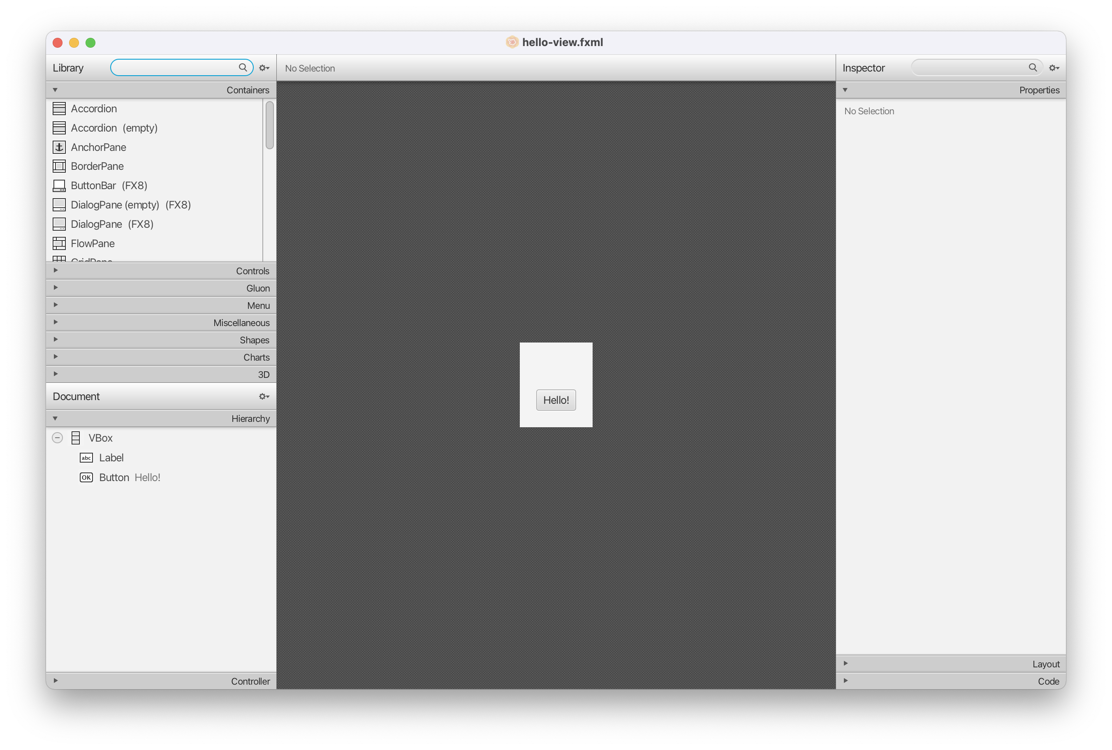
Installing JavaFX Scene Builder
Install JavaFX Scene Builder.

Slide 16
JavaFX Program Structure

Slide 17
A JavaFX Program
It consists of Stage, Scene and nodes.

Slide 18
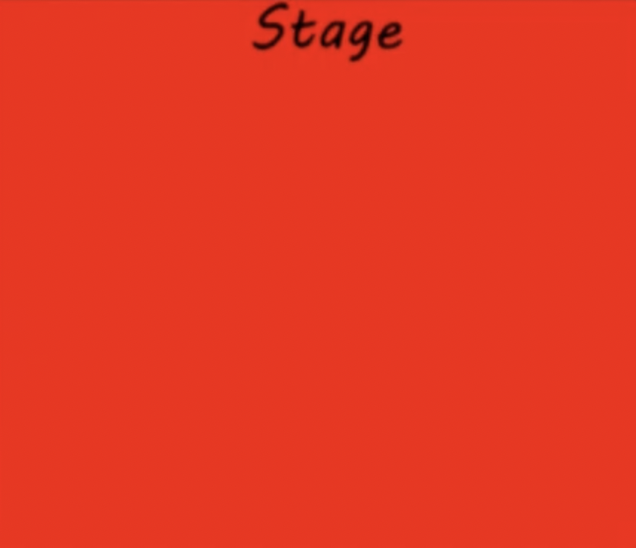
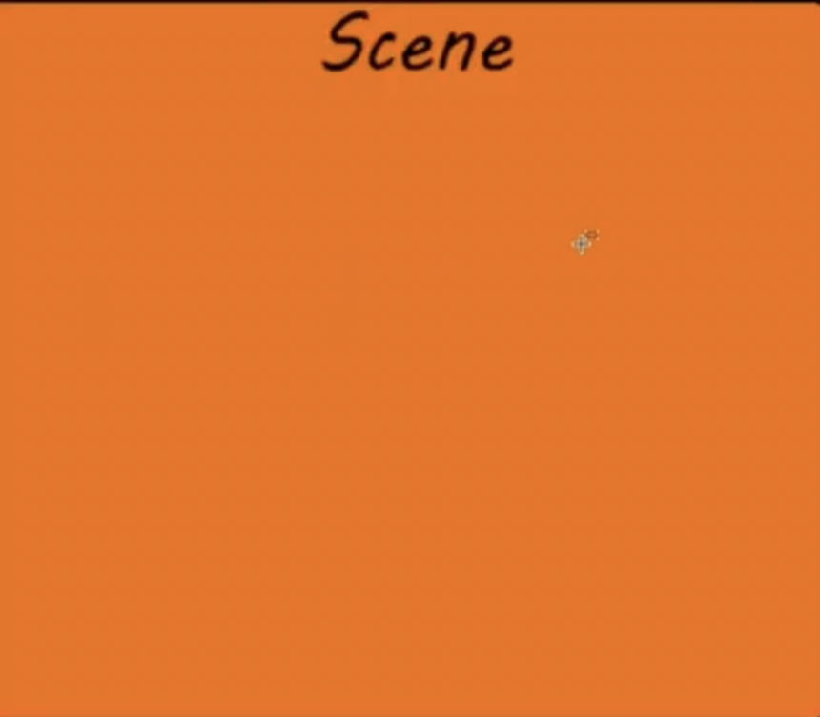
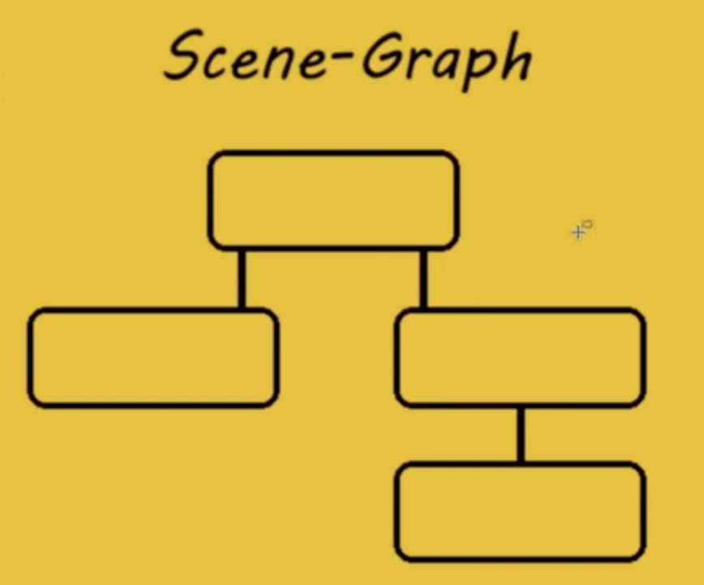
A JavaFX Program
It consists of Stage, Scene and nodes.

Slide 19
A JavaFX Program
It consists of Stage, Scene and nodes.

Slide 20
A JavaFX Program
It consists of Stage, Scene and nodes.

Slide 21
A JavaFX Program
It consists of Stage, Scene and nodes.

Slide 22
A JavaFX Program
It consists of Stage, Scene and nodes.

Slide 23
A JavaFX Program
It consists of Stage, Scene and nodes.

Slide 24
The Basic Structure of a JavaFX Program
JavaFX is a modern graphical user interface (GUI) framework for creating desktop and mobile applications. The program structure of a JavaFX application consists of the following components:
Application class: This is the entry point of the JavaFX application, which extends the javafx.application.Application class. It contains the main() method, which launches the application.
Stage class: A stage represents a top-level container or window of a JavaFX application. The stage is created in the start() method of the Application class.
Scene class: A scene represents the content of a stage, which is defined using the javafx.scene.Scene class. A scene can contain one or more nodes, such as buttons, text fields, labels, and images.
Layouts: JavaFX provides various layout classes to arrange nodes in the scene, such as VBox, HBox, BorderPane, GridPane, and FlowPane. These layouts help to organize the user interface elements in a structured manner.
Nodes: Nodes are the graphical components that are placed inside the scene, such as buttons, text fields, labels, and images. Each node is an instance of a class that extends the javafx.scene.Node class.
Event handling: JavaFX provides a comprehensive event handling mechanism to handle user interactions, such as button clicks, mouse movements, and key presses. Event handling is done using the EventHandler interface and the setOn<ActionEvent>() method.
CSS styling: JavaFX supports CSS styling for styling the user interface elements. You can use CSS to define the color, font, size, and layout of the nodes in the scene.
In summary, the program structure of a JavaFX application consists of the Application class, Stage class, Scene class, Layouts, Nodes, Event handling, and CSS styling.

Slide 25
The Basic Structure of a JavaFX Program
The javafx.application.Application class defines the essential framework for writing JavaFX programs.
We begin by writing a simple JavaFX program that illustrates the basic structure of a JavaFX program. Every JavaFX program is defined in a class that extends javafx.application.Application.

Slide 26
The Basic Structure of a JavaFX Program
A Stage object is a window. A Stage object called primary stage is automatically created by the JVM when the application is launched.
JavaFX names the Stage and Scene classes using the analogy from the theater. You may think of stage as the platform to support scenes, and nodes as actors to perform in the scenes.
You can create additional stages if needed.

Slide 27
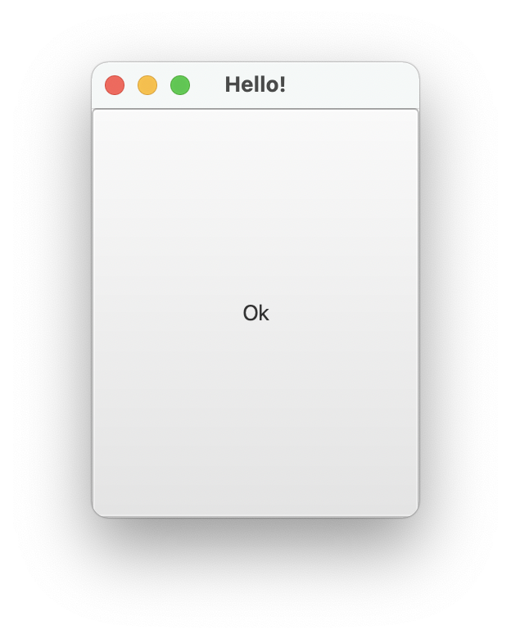
A JavaFX Program
import javafx.application.Application;
import javafx.scene.Scene;
import javafx.scene.control.Button;
import javafx.stage.Stage;
public class MyJavaFX extends Application {
@Override // Override the start method in the Application class
public void start(Stage primaryStage) {
// Create a button and place it in the scene
Button btOK = new Button("OK");
Scene scene = new Scene(btOK, 200, 250);
primaryStage.setTitle("MyJavaFX"); // Set the stage title
primaryStage.setScene(scene); // Place the scene in the stage
primaryStage.show(); // Display the stage
}
/**
* The main method is only needed for the IDE with limited
* JavaFX support. Not needed for running from the command line.
*/
public static void main(String[] args) {
launch(args);
}
}
MyJavaFX

Slide 28
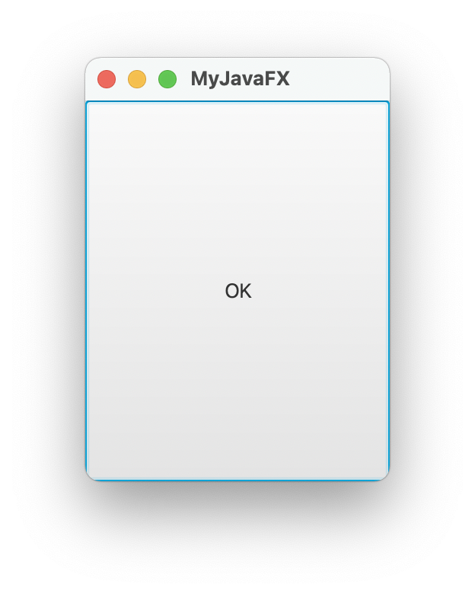
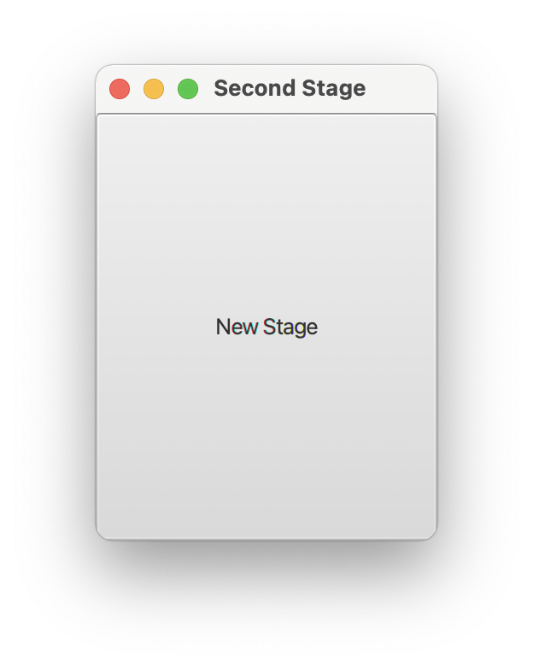
JavaFX Program with multiple Stage
package com.example.deneme5;
import javafx.application.Application;
import javafx.fxml.FXMLLoader;
import javafx.scene.Scene;
import javafx.scene.control.Button;
import javafx.stage.Stage;
import java.io.IOException;
public class HelloApplication extends Application {
@Override
public void start(Stage primaryStage) throws IOException {
// Create a scene and place a button in the scene
Scene scene = new Scene(new Button("OK"), 200, 250);
primaryStage.setTitle("MyJavaFX"); // Set the stage title
primaryStage.setScene(scene); // Place the scene in the stage
primaryStage.show(); // Display the stage
Stage stage = new Stage(); // Create a new stage
stage.setTitle("Second Stage"); // Set the stage title
// Set a scene with a button in the stage
stage.setScene(new Scene(new Button("New Stage"), 200, 250));
stage.show(); // Display the stage
}
/**
* The main method is only needed for the IDE with limited
* JavaFX support. Not needed for running from the command line.
*/
public static void main(String[] args) {
launch(args);
}
}
MultipleStageDemo

Slide 29
The Basic Structure of a JavaFX Program
When you run MyJavaFX, the window is. The button is always centered in the scene and occupies the entire window no matter how you resize it.
You can fix the problem by setting the position and size properties of a button.
However, a better approach is to use container classes, called panes, for automatically laying out the nodes in a desired location and size.
You place nodes inside a pane then place the pane into a scene.
A node is a visual component such as a shape, an image view, a UI control, a group, or a pane.

Slide 30
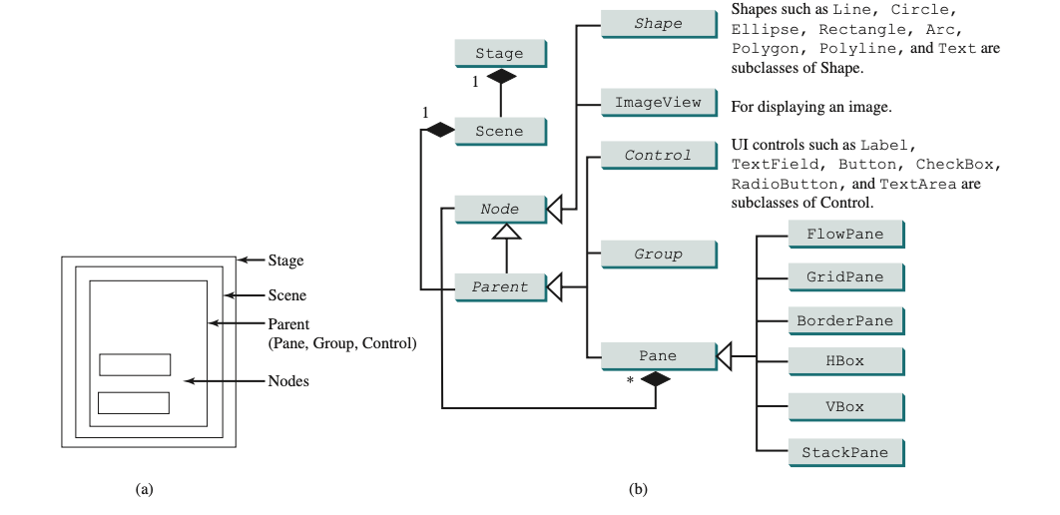
Pane, Group, UI Control, Shape

Slide 31
The Basic Structure of a JavaFX Program
A shape refers to a text, line, circle, ellipse, rectangle, arc, polygon, polyline, and so on.
A UI control refers to a label, button, check box, radio button, text field, text area, and so on.
A group is a container that groups a collection of nodes. You can apply transformations or effects to a group, which automatically apply to all the children in the group.
A scene can be displayed in a stage. Note a Scene can contain a Control, Group, or a Pane, but not a Shape or an ImageView.
A Pane or a Group can contain any subtype of Node. You can create a Scene using the constructor Scene(Parent, width, height) or Scene(Parent).

Slide 32
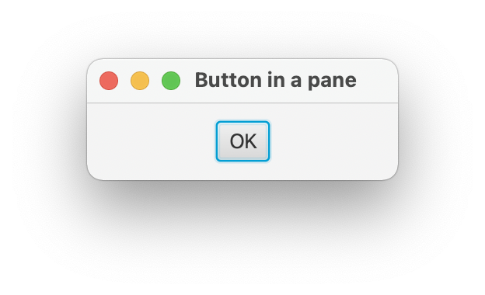
JavaFX Program with multiple Stage
import javafx.application.Application;
import javafx.fxml.FXMLLoader;
import javafx.scene.Scene;
import javafx.scene.control.Button;
import javafx.scene.layout.StackPane;
import javafx.stage.Stage;
import java.io.IOException;
public class HelloApplication extends Application {
@Override
public void start(Stage primaryStage) throws IOException {
// Create a scene and place a button in the scene
StackPane pane = new StackPane();
pane.getChildren().add(new Button("OK"));
Scene scene = new Scene(pane, 200, 50);
primaryStage.setTitle("Button in a pane"); // Set the stage title
primaryStage.setScene(scene); // Place the scene in the stage
primaryStage.show(); // Display the stage
}
/**
* The main method is only needed for the IDE with limited
* JavaFX support. Not needed for running from the command line.
*/
public static void main(String[] args) {
launch(args);
}
}
ButtonInPane

Slide 33
The Basic Structure of a JavaFX Program
The program creates a StackPane and adds a button as a child of the pane.
The getChildren() method returns an instance of javafx.collections .ObservableList. ObservableList behaves very much like an ArrayList for storing a collection of elements.
Invoking add(e) adds an element to the list. The StackPane places the nodes in the center of the pane on top of each other. Here, there is only one node in the pane. The StackPane respects a node’s preferred size. Therefore, you see the button displayed in its preferred size.

Slide 34
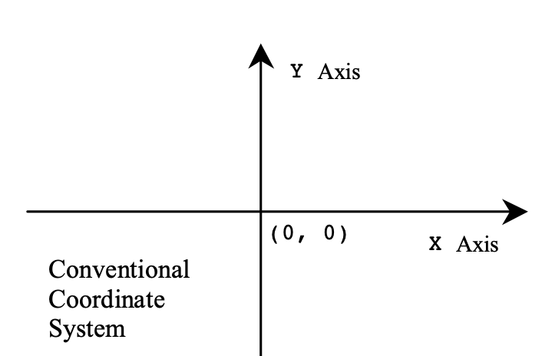
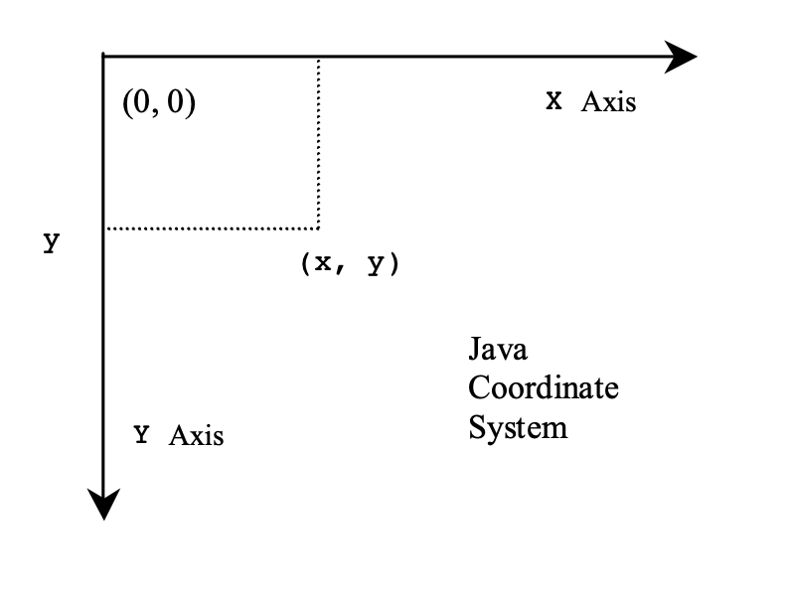
Show a shape on the screen
Coordinate system in Java

Slide 35
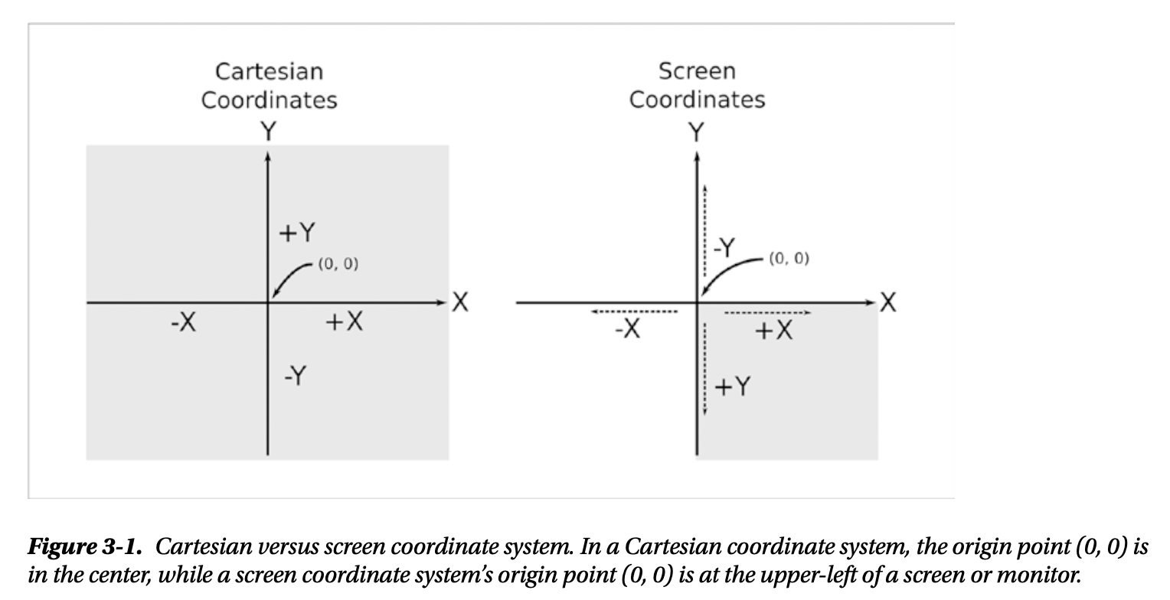
Show a shape on the screen
Coordinate system in Java

Slide 36
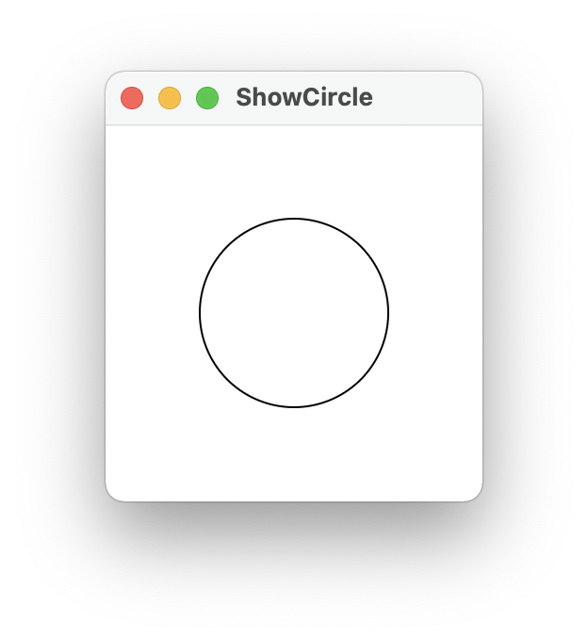
Show a shape on the screen
import javafx.application.Application;
import javafx.scene.Scene;
import javafx.scene.layout.Pane;
import javafx.scene.paint.Color;
import javafx.scene.shape.Circle;
import javafx.stage.Stage;
public class ShowCircle extends Application {
@Override // Override the start method in the Application class
public void start(Stage primaryStage) {
// Create a circle and set its properties
Circle circle = new Circle();
circle.setCenterX(100);
circle.setCenterY(100);
circle.setRadius(50);
circle.setStroke(Color.BLACK); // Set circle stroke color
circle.setFill(Color.WHITE);
// Create a pane to hold the circle
Pane pane = new Pane();
pane.getChildren().add(circle);
// Create a scene and place it in the stage
Scene scene = new Scene(pane, 200, 200);
primaryStage.setTitle("ShowCircle"); // Set the stage title
primaryStage.setScene(scene); // Place the scene in the stage
primaryStage.show(); // Display the stage
}
/**
* The main method is only needed for the IDE with limited
* JavaFX support. Not needed for running from the command line.
*/
public static void main(String[] args) {
launch(args);
}
}
ShowCircle

Slide 37
Property Binding
JavaFX introduces a new concept called binding property that enables a target object to be bound to a source object.
If the value in the source object changes, the target property is also changed automatically.
The target object is simply called a binding object or a binding property.

Slide 38
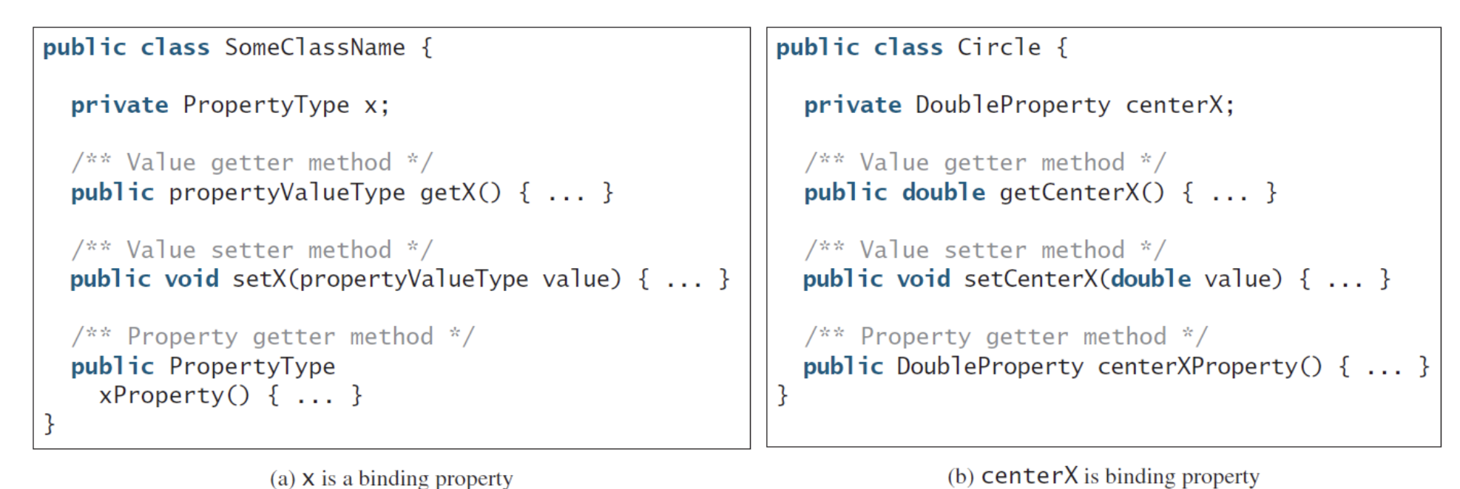
Property Binding
The circle is not centered after the window is resized. In order to display the circle centered as the window resizes, the x- and y-coordinates of the circle center need to be reset to the center of the pane.
This can be done by binding the centerX with pane’s width/2 and centerY with pane’s height/2Target.bind(source).

Slide 39
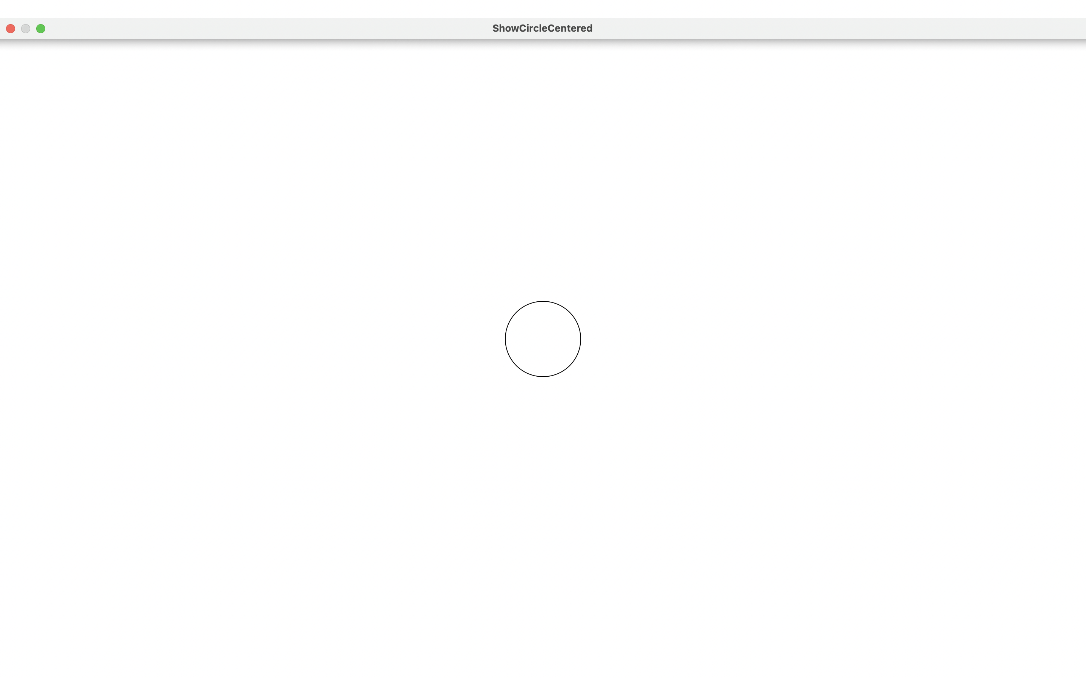
Property Binding
import javafx.application.Application;
import javafx.scene.Scene;
import javafx.scene.layout.Pane;
import javafx.scene.paint.Color;
import javafx.scene.shape.Circle;
import javafx.stage.Stage;
import java.io.IOException;
public class HelloApplication extends Application {
@Override
public void start(Stage primaryStage) throws IOException {
// Create a pane to hold the circle
Pane pane = new Pane();
// Create a circle and set its properties
Circle circle = new Circle();
circle.centerXProperty().bind(pane.widthProperty().divide(2));
circle.centerYProperty().bind(pane.heightProperty().divide(2));
circle.setRadius(50);
circle.setStroke(Color.BLACK);
circle.setFill(Color.WHITE);
pane.getChildren().add(circle); // Add circle to the pane
// Create a scene and place it in the stage
Scene scene = new Scene(pane, 200, 200);
primaryStage.setTitle("ShowCircleCentered"); // Set the stage title
primaryStage.setScene(scene); // Place the scene in the stage
primaryStage.show(); // Display the stage
}
public static void main(String[] args) {
launch(args)
}
}
ShowCircleCentered

Slide 40
Nodes
Nodes share many common properties. This section introduces two such properties: style and rotate.
JavaFX style properties are similar to cascading style sheets (CSS) used to specify the styles for HTML elements in a Web page.
Therefore, the style properties in JavaFX are called JavaFX CSS. In JavaFX, a style property is defined with a prefix –fx–. Each node has its own style properties.
The syntax for setting a style is styleName:value. Multiple style properties for a node can be set together separated by semicolon (;). For example, the following statement:
circle.setStyle("−fx−stroke: black; −fx−fill: red;");
sets two JavaFX CSS properties for a circle. This statement is equivalent to the following two
statements:
circle.setStroke(Color.BLACK);
circle.setFill(Color.RED);

Slide 41
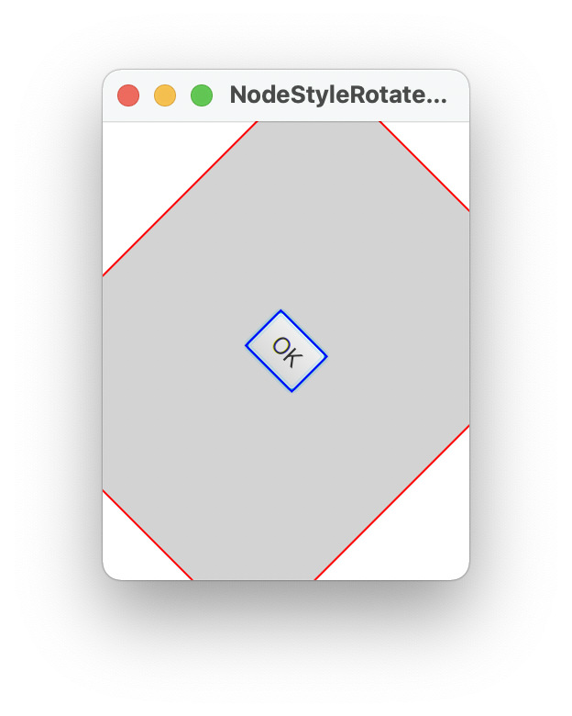
Nodes
import javafx.application.Application;
import javafx.scene.Scene;
import javafx.scene.control.Button;
import javafx.scene.layout.StackPane;
import javafx.stage.Stage;
import java.io.IOException;
public class HelloApplication extends Application {
@Override
public void start(Stage primaryStage) throws IOException {
// Create a scene and place a button in the scene
StackPane pane = new StackPane();
Button btOK = new Button("OK");
btOK.setStyle("-fx-border-color: blue;");
pane.getChildren().add(btOK);
pane.setRotate(45); // Rotate pane 45 degrees
pane.setStyle(
"-fx-border-color: red; -fx-background-color: lightgray;");
Scene scene = new Scene(pane, 200, 250);
primaryStage.setTitle("NodeStyleRotateDemo"); // Set the stage title
primaryStage.setScene(scene); // Place the scene in the stage
primaryStage.show(); // Display the stage
}
public static void main(String[] args) {
launch(args);
}
}
NodeStyleRotateDemo

Slide 42
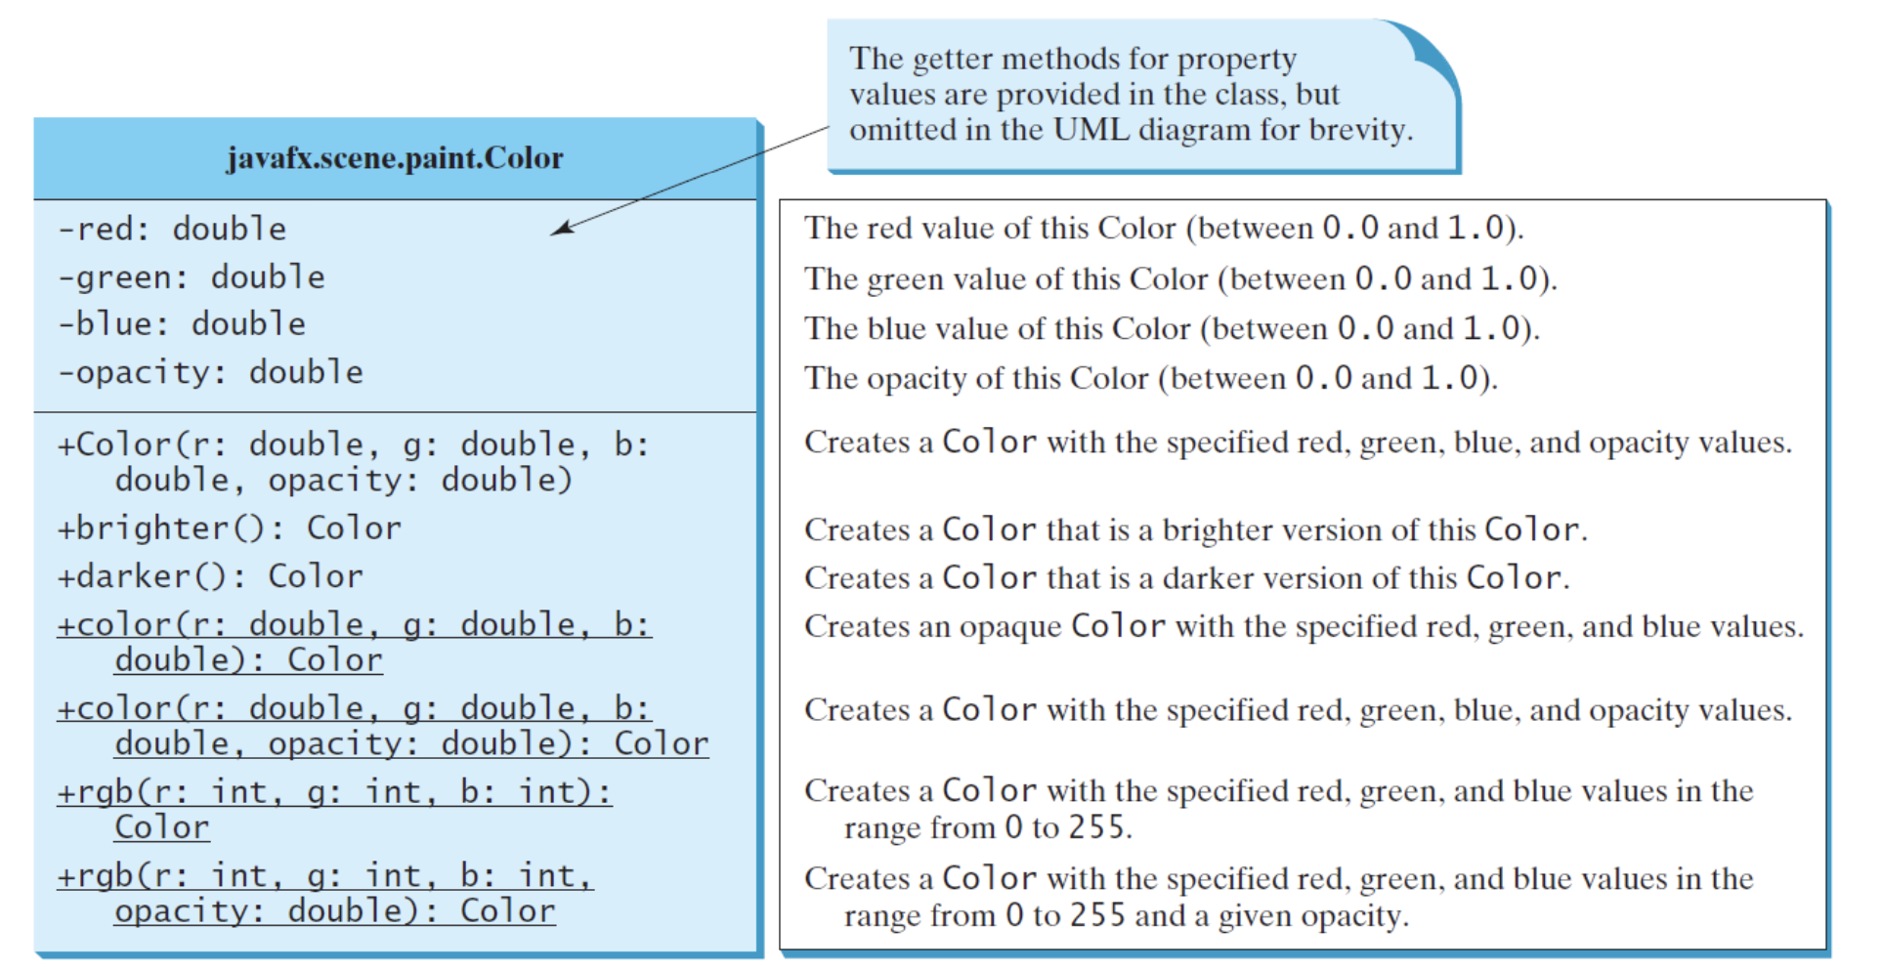
Color Class
Let's examine the color properties and methods.

Slide 43
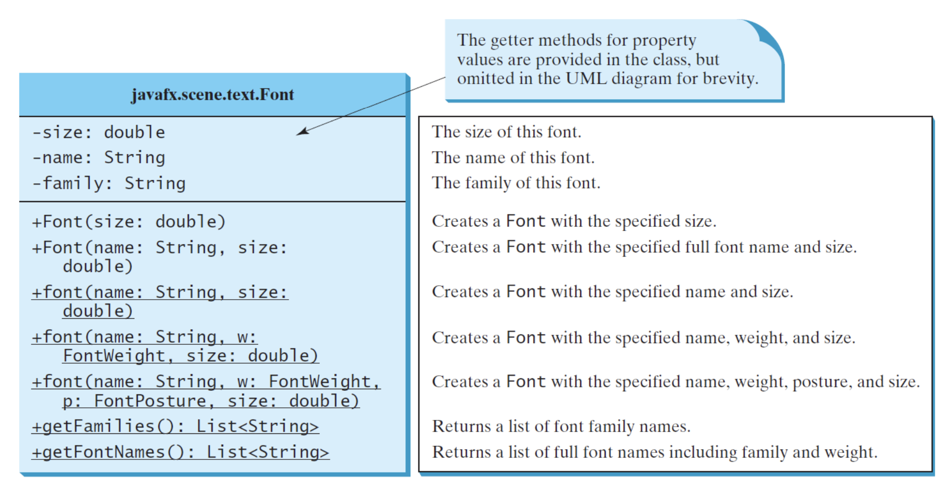
Font Class
Let's examine font properties and methods.

Slide 44
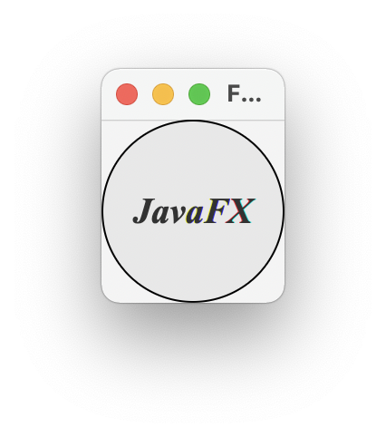
Font
import javafx.application.Application;
import javafx.scene.Scene;
import javafx.scene.control.Label;
import javafx.scene.layout.Pane;
import javafx.scene.layout.StackPane;
import javafx.scene.paint.Color;
import javafx.scene.shape.Circle;
import javafx.scene.text.Font;
import javafx.scene.text.FontPosture;
import javafx.scene.text.FontWeight;
import javafx.stage.Stage;
import java.io.IOException;
public class HelloApplication extends Application {
@Override
public void start(Stage primaryStage) throws IOException {
// Create a pane to hold the circle
Pane pane = new StackPane();
// Create a circle and set its properties
Circle circle = new Circle();
circle.setRadius(50);
circle.setStroke(Color.BLACK);
circle.setFill(new Color(0.5, 0.5, 0.5, 0.1));
pane.getChildren().add(circle); // Add circle to the pane
// Create a label and set its properties
Label label = new Label("JavaFX");
label.setFont(Font.font("Times New Roman",
FontWeight.BOLD, FontPosture.ITALIC, 20));
pane.getChildren().add(label);
// Create a scene and place it in the stage
Scene scene = new Scene(pane);
primaryStage.setTitle("FontDemo"); // Set the stage title
primaryStage.setScene(scene); // Place the scene in the stage
primaryStage.show(); // Display the stage
}
public static void main(String[] args) {
launch(args);
}
}
FontDemo

Slide 45
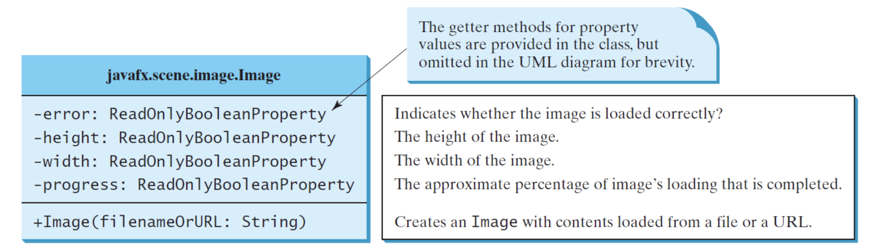
Image Class
Let's examine the image properties and methods.

Slide 46
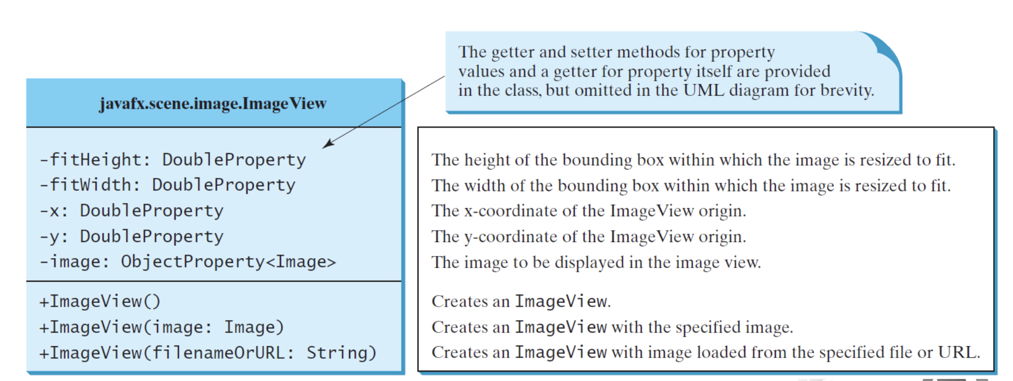
ImageView Class
Let's examine ImageView properties and methods.

Slide 47

ImageView
package com.example.deneme5;
import javafx.application.Application;
import javafx.geometry.Insets;
import javafx.scene.Scene;
import javafx.scene.image.Image;
import javafx.scene.image.ImageView;
import javafx.scene.layout.HBox;
import javafx.scene.layout.Pane;
import javafx.stage.Stage;
import java.io.IOException;
public class HelloApplication extends Application {
@Override
public void start(Stage primaryStage) throws IOException {
// Create a pane to hold the image views
Pane pane = new HBox(10);
pane.setPadding(new Insets(5, 5, 5, 5));
Image image = new Image("turk.gif");
pane.getChildren().add(new ImageView(image));
ImageView imageView2 = new ImageView(image);
imageView2.setFitHeight(100);
imageView2.setFitWidth(100);
pane.getChildren().add(imageView2);
ImageView imageView3 = new ImageView(image);
imageView3.setRotate(90);
pane.getChildren().add(imageView3);
// Create a scene and place it in the stage
Scene scene = new Scene(pane);
primaryStage.setTitle("ShowImage"); // Set the stage title
primaryStage.setScene(scene); // Place the scene in the stage
primaryStage.show(); // Display the stage
}
public static void main(String[] args) {
launch(args);
}
}
ShowImage

Slide 48
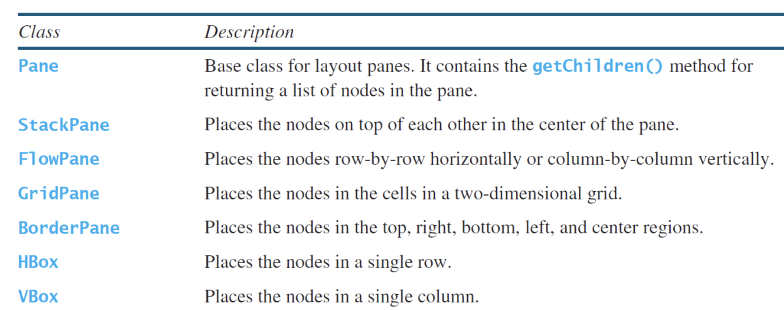
Panes
Panes and groups are the containers for holding nodes. The Group class is often used to group nodes and to perform transformation and scale as a group. Panes and UI control objects are resizable, but group, shape, and text objects are not resizable. JavaFX provides many types of panes for organizing nodes in a container

Slide 49
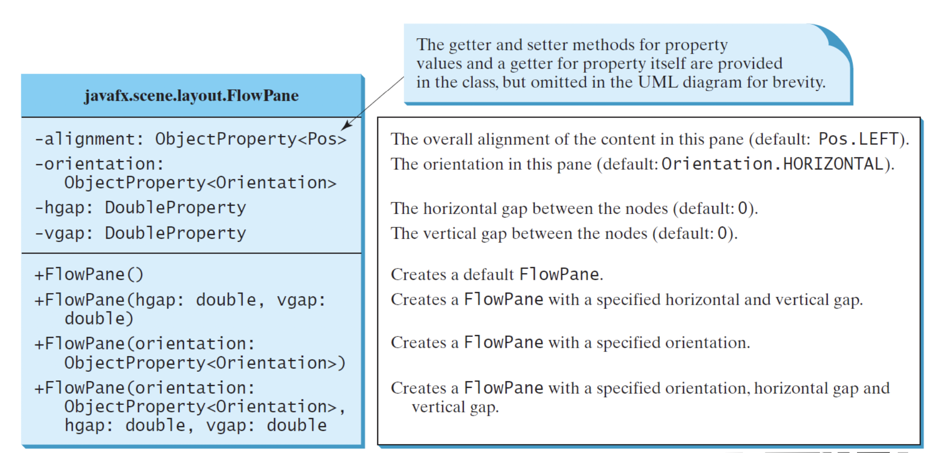
FlowPane Class
Let's examine FlowPane properties and methods.

Slide 50
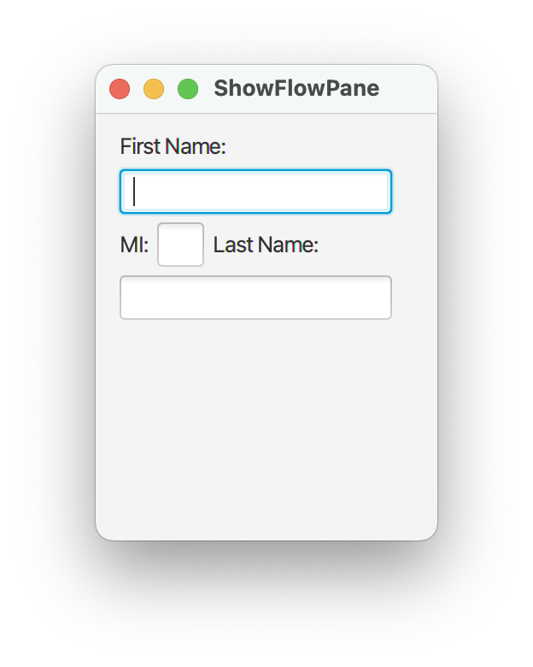
FlowPane
package com.example.deneme5;
import javafx.application.Application;
import javafx.geometry.Insets;
import javafx.scene.Scene;
import javafx.scene.control.Label;
import javafx.scene.control.TextField;
import javafx.scene.layout.FlowPane;
import javafx.stage.Stage;
import java.io.IOException;
public class HelloApplication extends Application {
@Override
public void start(Stage primaryStage) throws IOException {
FlowPane pane = new FlowPane();
pane.setPadding(new Insets(11, 12, 13, 14));
pane.setHgap(5); // Set hGap to 5px
pane.setVgap(5);
// Place nodes in the pane
pane.getChildren().addAll(new Label("First Name:"),
new TextField(), new Label("MI:"));
TextField tfMi = new TextField();
tfMi.setPrefColumnCount(1);
pane.getChildren().addAll(tfMi, new Label("Last Name:"),
new TextField());
// Create a scene and place it in the stage
Scene scene = new Scene(pane, 200, 250);
primaryStage.setTitle("ShowFlowPane"); // Set the stage title
primaryStage.setScene(scene); // Place the scene in the stage
primaryStage.show(); // Display the stage
}
public static void main(String[] args) {
launch(args);
}
}
ShowFlowPane

Slide 51
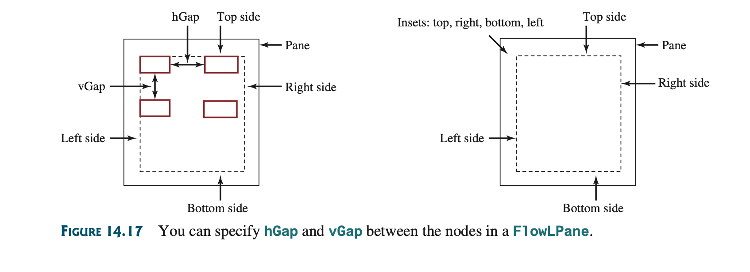
FlowPane Class
The program creates a FlowPane (line 13) and sets its padding property with an Insets object (line 14). An Insets object specifies the size of the border of a pane.
The constructor Insets(11, 12, 13, 14) creates an Insets with the border sizes for top (11), right (12), bottom (13), and left (14) in pixels.
You can also use the constructor Insets(value) to create an Insets with the same value for all four sides.
The hGap and vGap properties are in lines 15 and 16 to specify the horizontal gap and vertical gap, respectively, between two nodes in the pane.

Slide 52
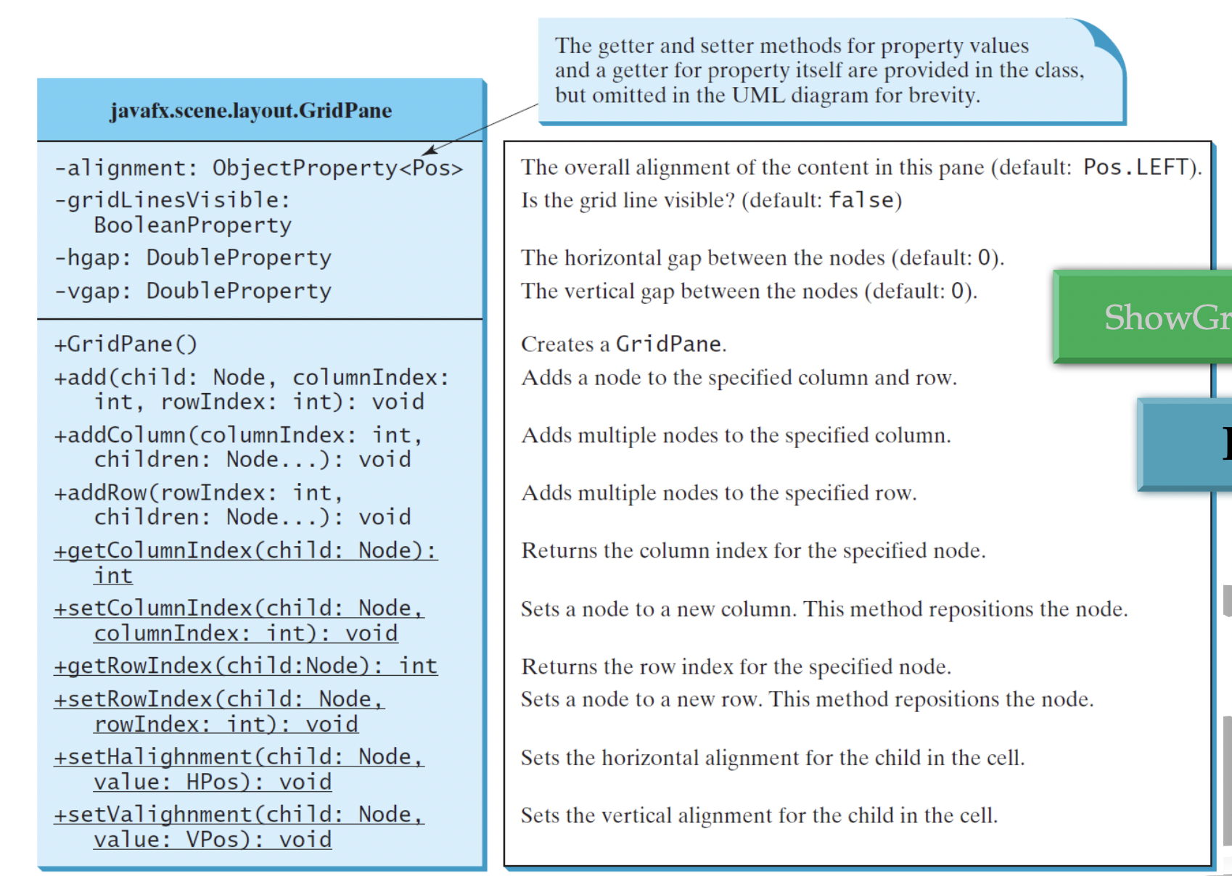
GridPane Class
Let's examine the GridPane properties and methods.

Slide 53
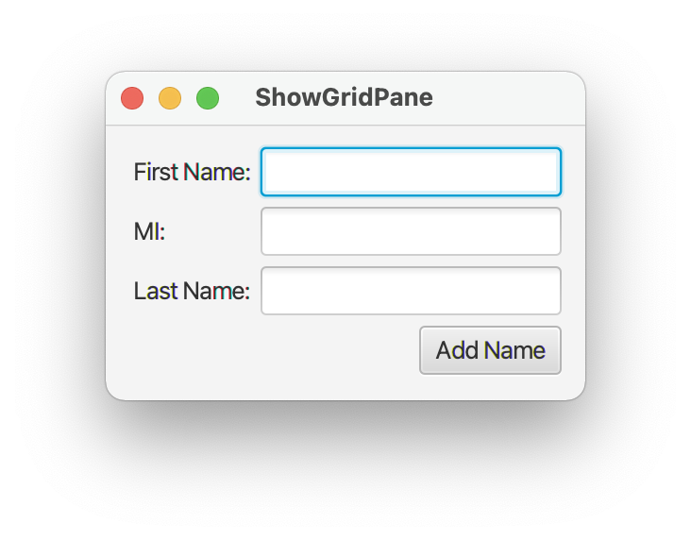
GridPane
package com.example.deneme5;
import javafx.application.Application;
import javafx.geometry.HPos;
import javafx.geometry.Insets;
import javafx.geometry.Pos;
import javafx.scene.Scene;
import javafx.scene.control.Button;
import javafx.scene.control.Label;
import javafx.scene.control.TextField;
import javafx.scene.layout.GridPane;
import javafx.stage.Stage;
import java.io.IOException;
public class HelloApplication extends Application {
@Override
public void start(Stage primaryStage) throws IOException {
// Create a pane and set its properties
GridPane pane = new GridPane();
pane.setAlignment(Pos.CENTER); // Set center alignment
pane.setPadding(new Insets(11.5, 12.5, 13.5, 14.5));
pane.setHgap(5.5);
pane.setVgap(5.5); // Set vGap to 5.5px
// Place nodes in the pane
pane.add(new Label("First Name:"), 0, 0);
pane.add(new TextField(), 1, 0);
pane.add(new Label("MI:"), 0, 1);
pane.add(new TextField(), 1, 1);
pane.add(new Label("Last Name:"), 0, 2);
pane.add(new TextField(), 1, 2);
Button btAdd = new Button("Add Name");
pane.add(btAdd, 1, 3);
GridPane.setHalignment(btAdd, HPos.RIGHT);
// Create a scene and place it in the stage
Scene scene = new Scene(pane);
primaryStage.setTitle("ShowGridPane"); // Set the stage title
primaryStage.setScene(scene); // Place the scene in the stage
primaryStage.show(); // Display the stage
}
public static void main(String[] args) {
launch(args);
}
}
ShowGridPane

Slide 54
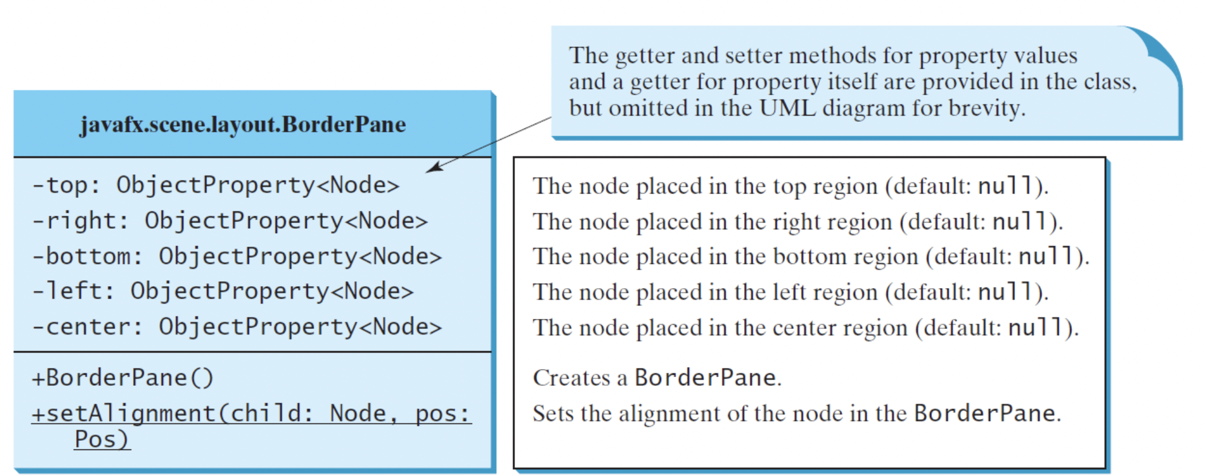
BorderPane Class
Let's examine the BorderPane properties and methods.

Slide 55
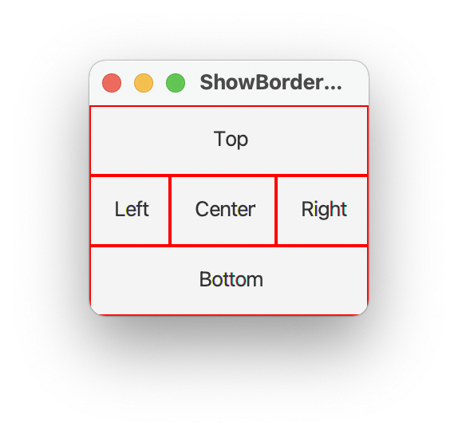
BorderPane
package com.example.deneme5;
import javafx.application.Application;
import javafx.geometry.Insets;
import javafx.scene.Scene;
import javafx.scene.control.Label;
import javafx.scene.layout.BorderPane;
import javafx.scene.layout.StackPane;
import javafx.stage.Stage;
public class HelloApplication extends Application {
@Override // Override the start method in the Application class
public void start(Stage primaryStage) {
// Create a border pane
BorderPane pane = new BorderPane();
// Place nodes in the pane
pane.setTop(new CustomPane("Top"));
pane.setRight(new CustomPane("Right"));
pane.setBottom(new CustomPane("Bottom"));
pane.setLeft(new CustomPane("Left"));
pane.setCenter(new CustomPane("Center"));
// Create a scene and place it in the stage
Scene scene = new Scene(pane);
primaryStage.setTitle("ShowBorderPane"); // Set the stage title
primaryStage.setScene(scene); // Place the scene in the stage
primaryStage.show(); // Display the stage
}
}
// Define a custom pane to hold a label in the center of the pane
class CustomPane extends StackPane {
public CustomPane(String title) {
getChildren().add(new Label(title));
setStyle("-fx-border-color: red");
setPadding(new Insets(11.5, 12.5, 13.5, 14.5));
}
}
ShowBorderPane

Slide 56
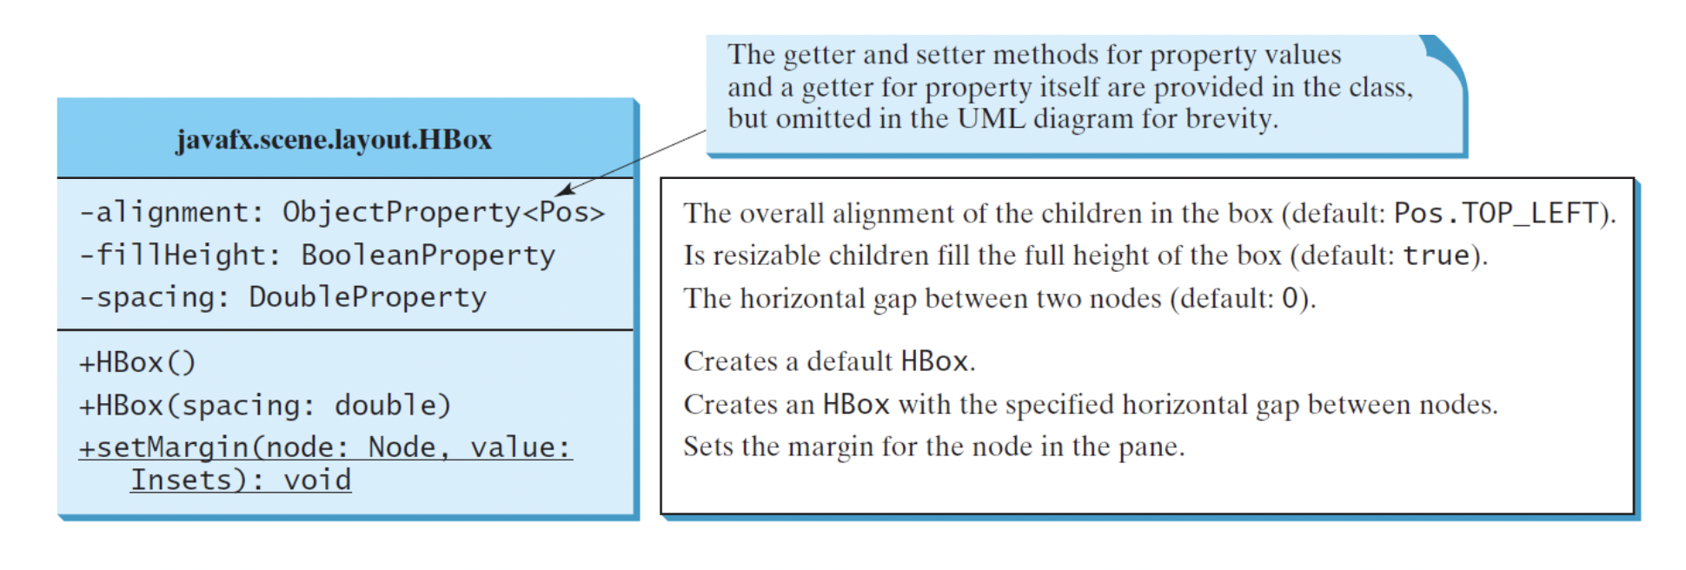
HBox Class
Let's examine HBox properties and methods.

Slide 57
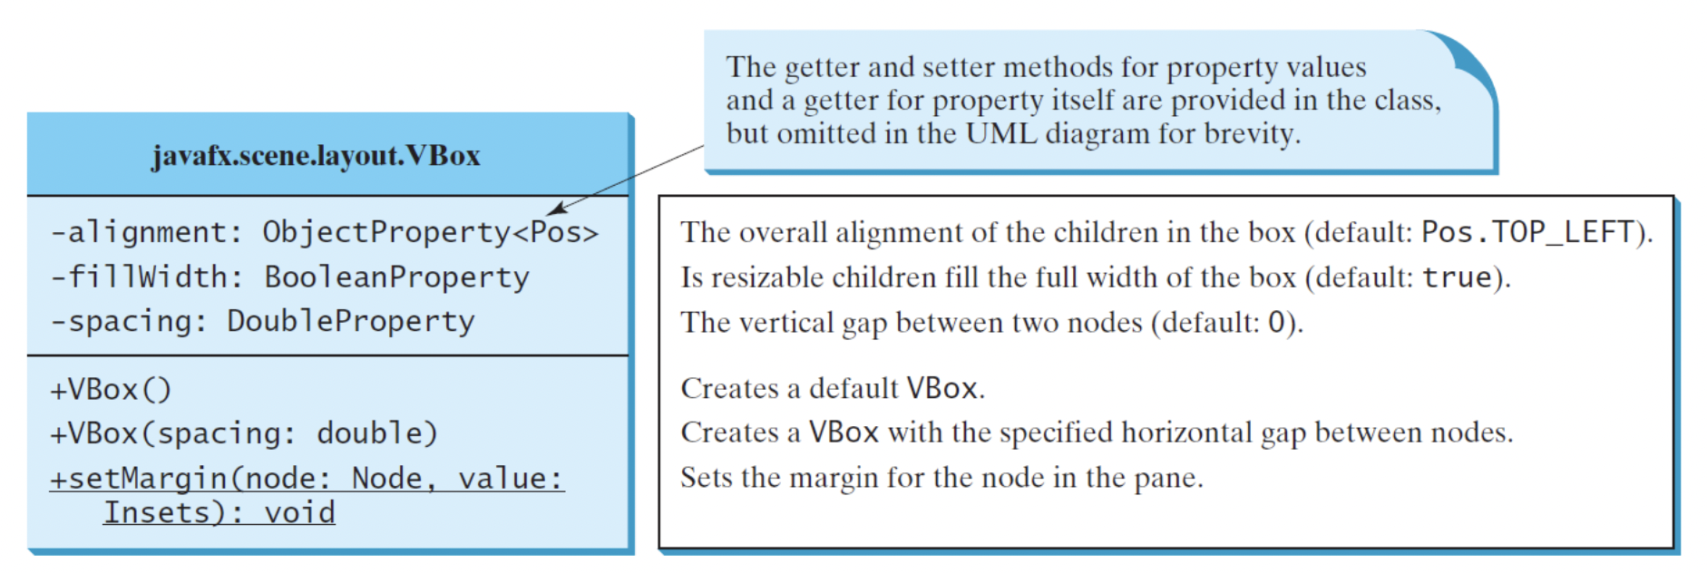
VBox Class
Let's examine VBox properties and methods.

Slide 58
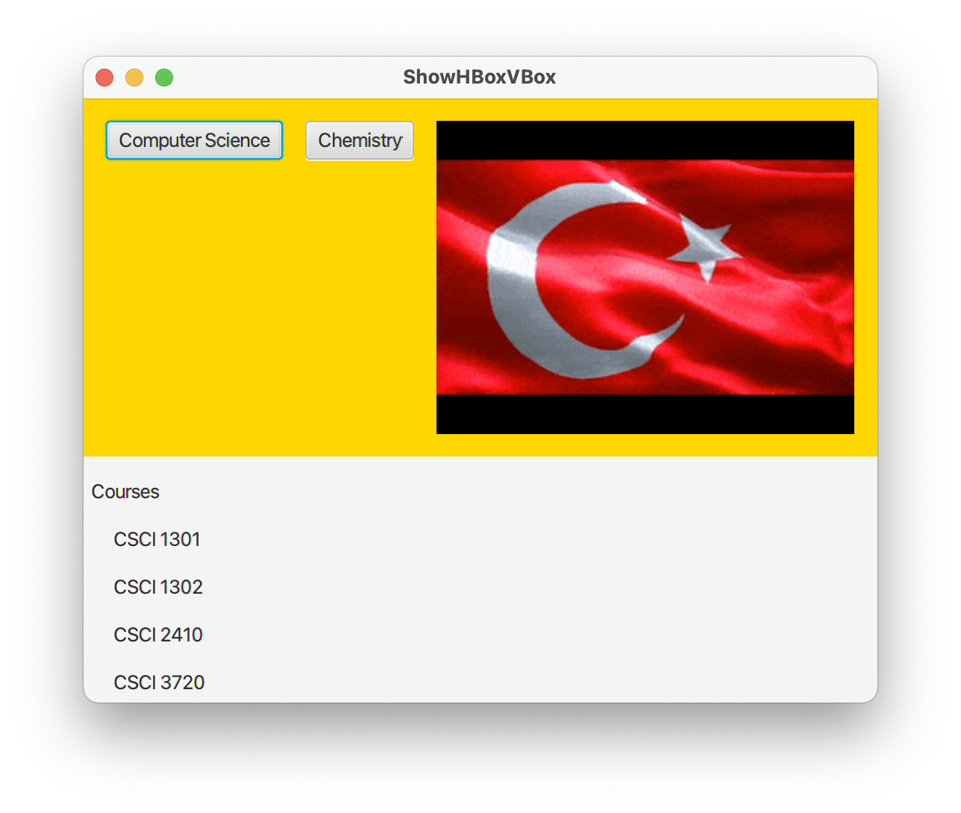
HBox, VBox
package com.example.deneme5;
import javafx.application.Application;
import javafx.geometry.Insets;
import javafx.scene.Scene;
import javafx.scene.control.Button;
import javafx.scene.control.Label;
import javafx.scene.layout.BorderPane;
import javafx.scene.layout.HBox;
import javafx.scene.layout.VBox;
import javafx.stage.Stage;
import javafx.scene.image.Image;
import javafx.scene.image.ImageView;
public class HelloApplication extends Application {
@Override // Override the start method in the Application class
public void start(Stage primaryStage) {
// Create a border pane
BorderPane pane = new BorderPane();
// Place nodes in the pane
pane.setTop(getHBox());
pane.setLeft(getVBox());
// Create a scene and place it in the stage
Scene scene = new Scene(pane);
primaryStage.setTitle("ShowHBoxVBox"); // Set the stage title
primaryStage.setScene(scene); // Place the scene in the stage
primaryStage.show(); // Display the stage
}
private HBox getHBox() {
HBox hBox = new HBox(15); // Create an HBox with 15px spacing
hBox.setPadding(new Insets(15, 15, 15, 15));
hBox.setStyle("-fx-background-color: gold");
hBox.getChildren().add(new Button("Computer Science"));
hBox.getChildren().add(new Button("Chemistry"));
ImageView imageView = new ImageView(new Image("turk.gif"));
hBox.getChildren().add(imageView);
return hBox;
}
private VBox getVBox() {
VBox vBox = new VBox(15); // Create a VBox with 15px spacing
vBox.setPadding(new Insets(15, 5, 5, 5));
vBox.getChildren().add(new Label("Courses"));
Label[] courses = {new Label("CSCI 1301"), new Label("CSCI 1302"),
new Label("CSCI 2410"), new Label("CSCI 3720")};
for (Label course: courses) {
VBox.setMargin(course, new Insets(0, 0, 0, 15));
vBox.getChildren().add(course);
}
return vBox;
}
/**
* The main method is only needed for the IDE with limited
* JavaFX support. Not needed for running from the command line.
*/
public static void main(String[] args) {
launch(args);
}
}
ShowHBoxVBox

Slide 59
Shapes

Slide 60
Shapes Class
The Shape class is the abstract base class that defines the common properties for all shapes. Among them are the fill, stroke, and strokeWidth properties.
The fill property specifies a color that fills the interior of a shape.
The stroke property specifies a color that is used to draw the outline of a shape.
The strokeWidth property specifies the width of the outline of a shape.

Slide 61
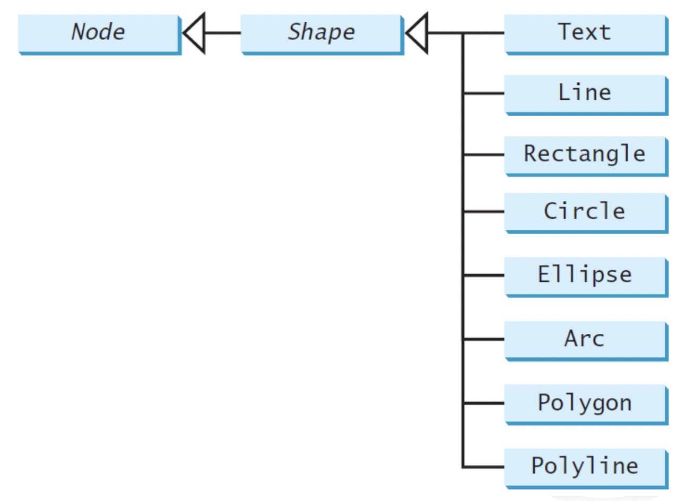
Shapes Class
This section introduces the classes Text, Line, Rectangle, Circle, Ellipse, Arc, Polygon, and Polyline for drawing texts and simple shapes. All these are subclasses of Shape.

Slide 62
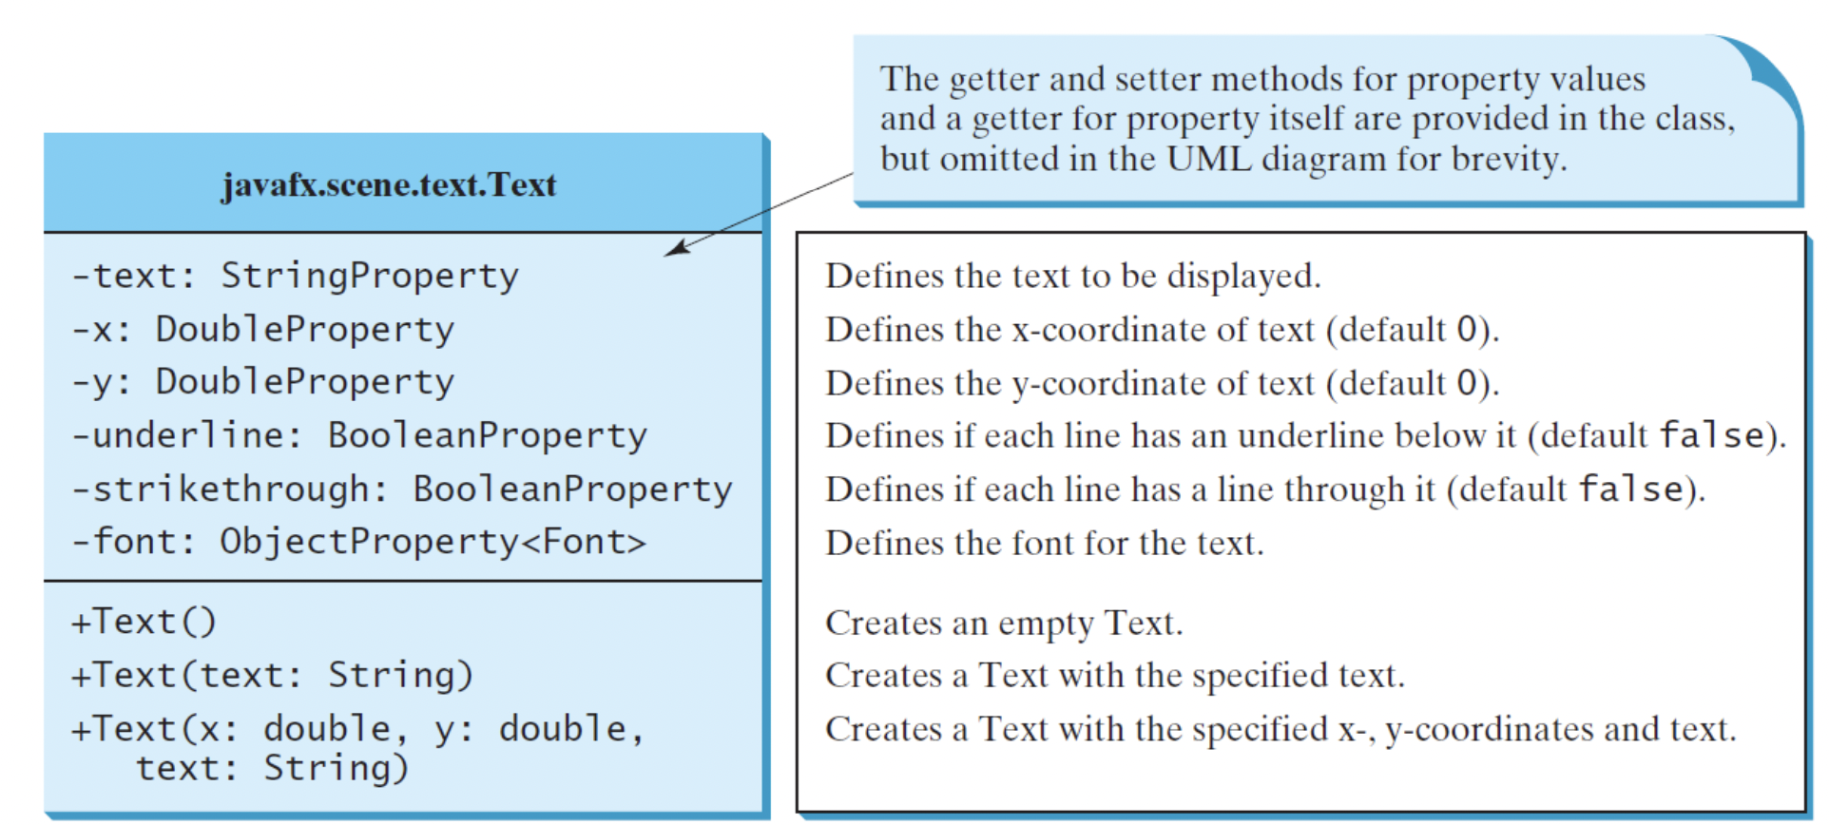
Text
Let's examine text, its properties, and its methods.

Slide 63
Text
The Text class defines a node that displays a string at a starting point (x, y).
A Text object is usually placed in a pane.
The pane’s upper-left corner point is (0, 0) and the bottom-right point is (pane.getWidth(), pane.getHeight()).
A string may be displayed in multiple lines separated by \n.

Slide 64
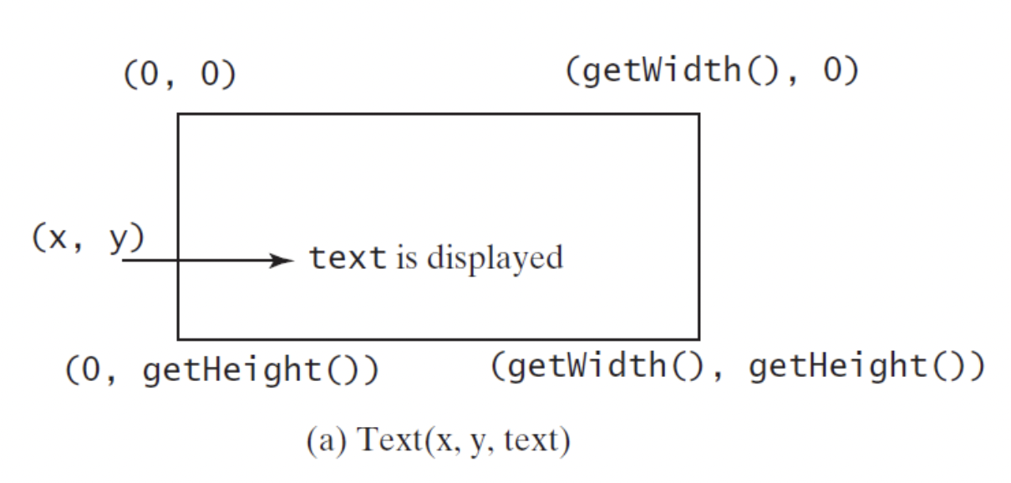
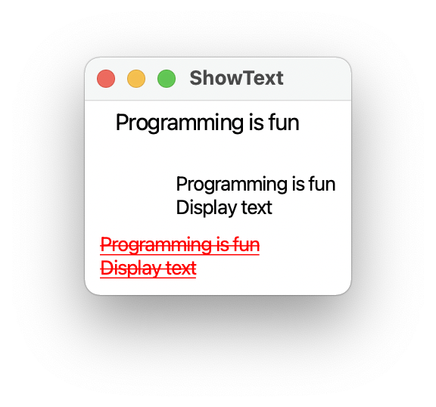
Text
package com.example.deneme5;
import javafx.application.Application;
import javafx.scene.Scene;
import javafx.scene.layout.Pane;
import javafx.scene.paint.Color;
import javafx.geometry.Insets;
import javafx.stage.Stage;
import javafx.scene.text.Text;
import javafx.scene.text.Font;
import javafx.scene.text.FontWeight;
import javafx.scene.text.FontPosture;
public class HelloApplication extends Application {
@Override // Override the start method in the Application class
public void start(Stage primaryStage) {
// Create a pane to hold the texts
Pane pane = new Pane();
pane.setPadding(new Insets(5, 5, 5, 5));
Text text1 = new Text(20, 20, "Programming is fun");
text1.setFont(Font.font("Courier", FontWeight.BOLD,
FontPosture.ITALIC, 15));
pane.getChildren().add(text1);
Text text2 = new Text(60, 60, "Programming is fun\nDisplay text");
pane.getChildren().add(text2);
Text text3 = new Text(10, 100, "Programming is fun\nDisplay text");
text3.setFill(Color.RED);
text3.setUnderline(true); // Underline for text3
text3.setStrikethrough(true); // Strikethrough for text3
pane.getChildren().add(text3);
// Create a scene and place it in the stage
Scene scene = new Scene(pane);
primaryStage.setTitle("ShowText"); // Set the stage title
primaryStage.setScene(scene); // Place the scene in the stage
primaryStage.show(); // Display the stage
}
/**
* The main method is only needed for the IDE with limited
* JavaFX support. Not needed for running from the command line.
*/
public static void main(String[] args) {
launch(args);
}
}
ShowText

Slide 65
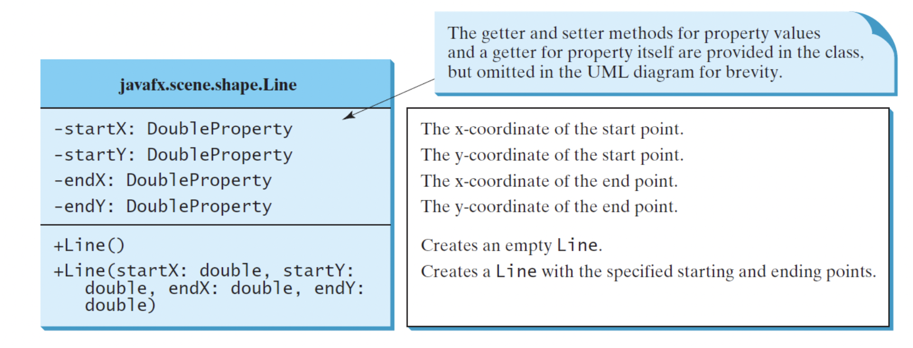
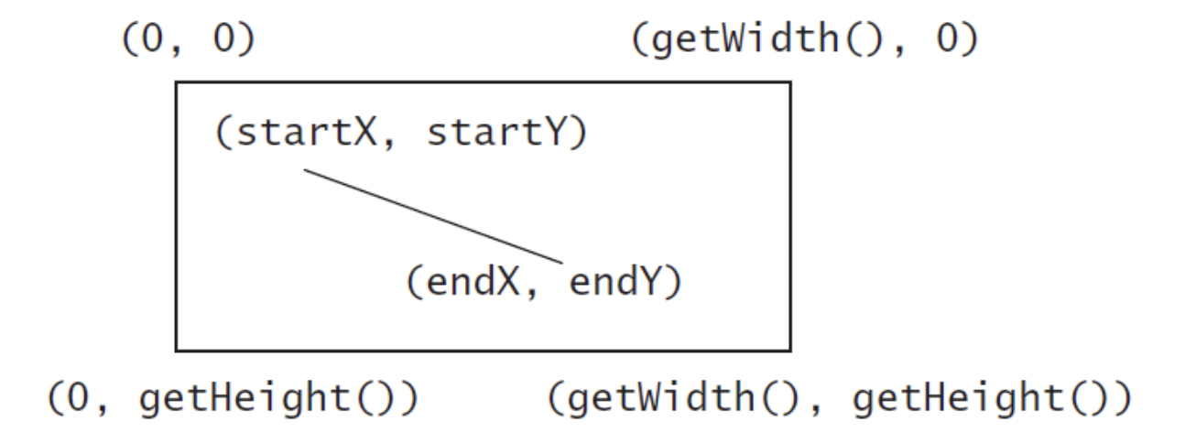
Line
Let's examine the line, its properties and methods.

Slide 66
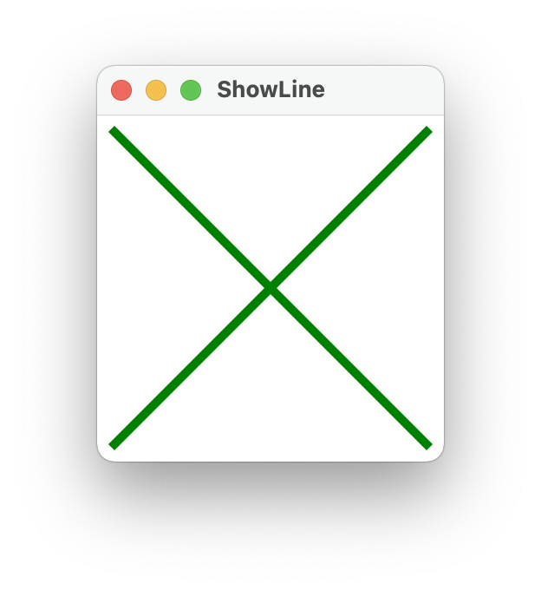
Line
package com.example.deneme5;
import javafx.application.Application;
import javafx.scene.Scene;
import javafx.scene.layout.Pane;
import javafx.scene.paint.Color;
import javafx.stage.Stage;
import javafx.scene.shape.Line;
public class HelloApplication extends Application {
@Override // Override the start method in the Application class
public void start(Stage primaryStage) {
// Create a scene and place it in the stage
Scene scene = new Scene(new LinePane(), 200, 200);
primaryStage.setTitle("ShowLine"); // Set the stage title
primaryStage.setScene(scene); // Place the scene in the stage
primaryStage.show(); // Display the stage
}
}
class LinePane extends Pane {
public LinePane() {
Line line1 = new Line(10, 10, 10, 10);
line1.endXProperty().bind(widthProperty().subtract(10));
line1.endYProperty().bind(heightProperty().subtract(10));
line1.setStrokeWidth(5);
line1.setStroke(Color.GREEN);
getChildren().add(line1);
Line line2 = new Line(10, 10, 10, 10);
line2.startXProperty().bind(widthProperty().subtract(10));
line2.endYProperty().bind(heightProperty().subtract(10));
line2.setStrokeWidth(5);
line2.setStroke(Color.GREEN);
getChildren().add(line2);
}
}
ShowLine

Slide 67
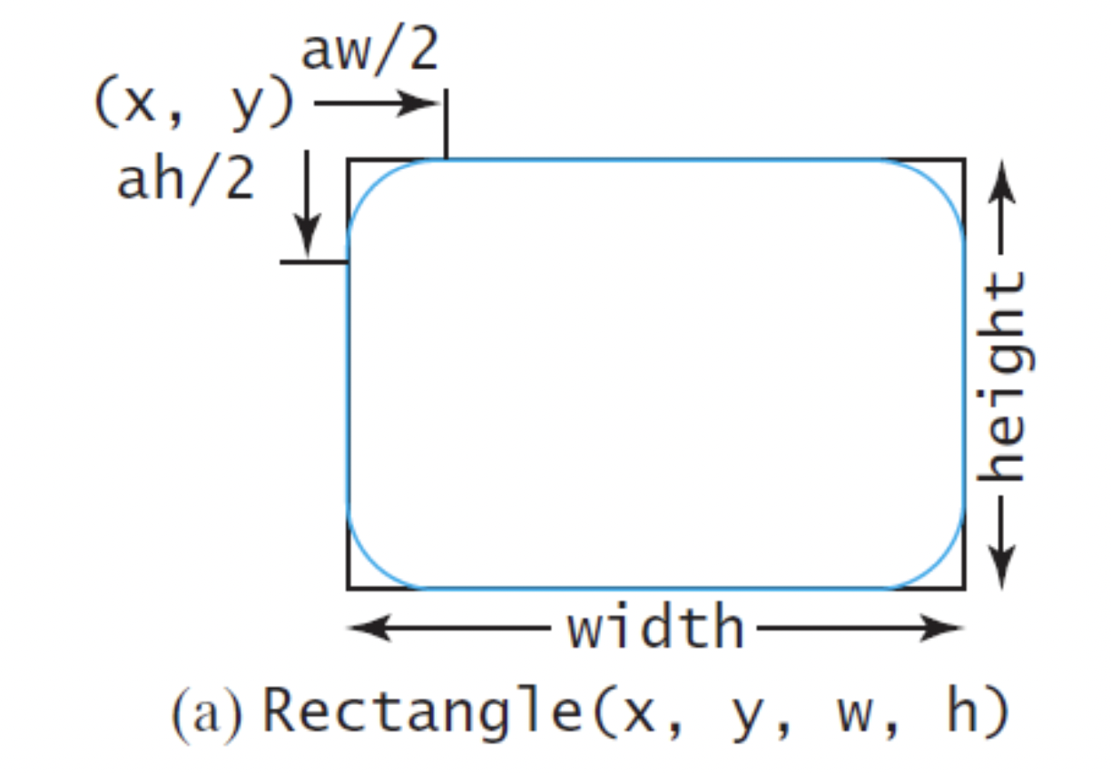
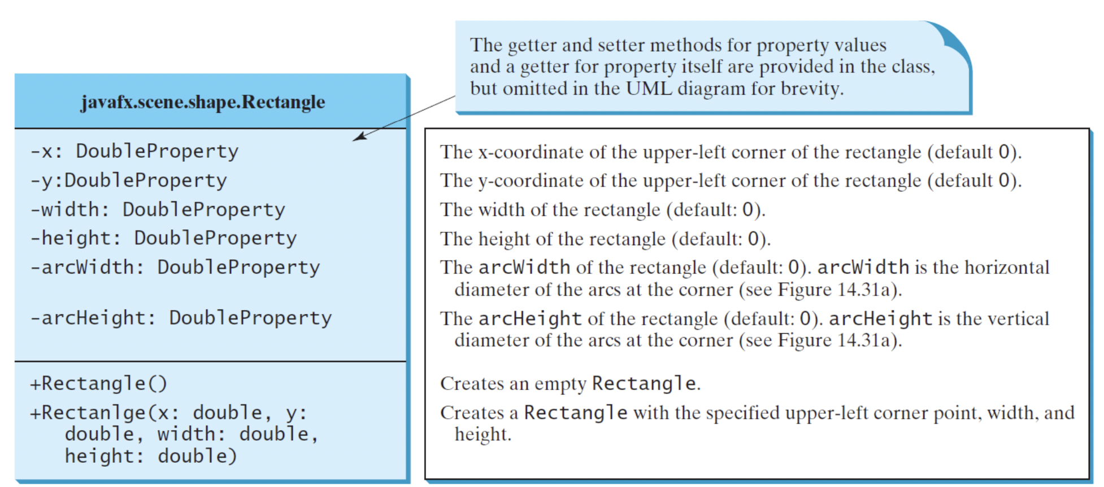
Rectangle
Let's examine Rectangle, its properties and methods.

Slide 68
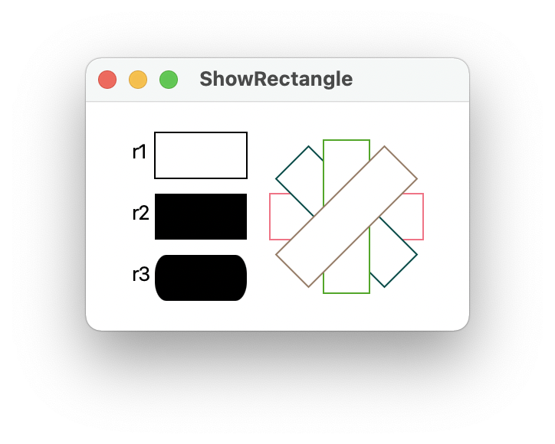
Rectangle
package com.example.deneme5;
import javafx.application.Application;
import javafx.scene.Group;
import javafx.scene.Scene;
import javafx.scene.layout.BorderPane;
import javafx.scene.layout.Pane;
import javafx.scene.paint.Color;
import javafx.scene.shape.Line;
import javafx.stage.Stage;
import javafx.scene.text.Text;
import javafx.scene.shape.Rectangle;
public class HelloApplication extends Application {
@Override // Override the start method in the Application class
public void start(Stage primaryStage) {
// Create rectangles
Rectangle r1 = new Rectangle(25, 10, 60, 30);
r1.setStroke(Color.BLACK);
r1.setFill(Color.WHITE);
Rectangle r2 = new Rectangle(25, 50, 60, 30);
Rectangle r3 = new Rectangle(25, 90, 60, 30);
r3.setArcWidth(15);
r3.setArcHeight(25);
// Create a group and add nodes to the group
Group group = new Group();
group.getChildren().addAll(new Text(10, 27, "r1"), r1,
new Text(10, 67, "r2"), r2, new Text(10, 107, "r3"), r3);
for (int i = 0; i < 4; i++) {
Rectangle r = new Rectangle(100, 50, 100, 30);
r.setRotate(i * 360 / 8);
r.setStroke(Color.color(Math.random(), Math.random(),
Math.random()));
r.setFill(Color.WHITE);
group.getChildren().add(r);
}
// Create a scene and place it in the stage
Scene scene = new Scene(new BorderPane(group), 250, 150);
primaryStage.setTitle("ShowRectangle"); // Set the stage title
primaryStage.setScene(scene); // Place the scene in the stage
primaryStage.show(); // Display the stage
}
/**
* The main method is only needed for the IDE with limited
* JavaFX support. Not needed for running from the command line.
*/
public static void main(String[] args) {
launch(args);
}
}
class LinePane extends Pane {
public LinePane() {
Line line1 = new Line(10, 10, 10, 10);
line1.endXProperty().bind(widthProperty().subtract(10));
line1.endYProperty().bind(heightProperty().subtract(10));
line1.setStrokeWidth(5);
line1.setStroke(Color.GREEN);
getChildren().add(line1);
Line line2 = new Line(10, 10, 10, 10);
line2.startXProperty().bind(widthProperty().subtract(10));
line2.endYProperty().bind(heightProperty().subtract(10));
line2.setStrokeWidth(5);
line2.setStroke(Color.GREEN);
getChildren().add(line2);
}
}
ShowRectangle

Slide 69
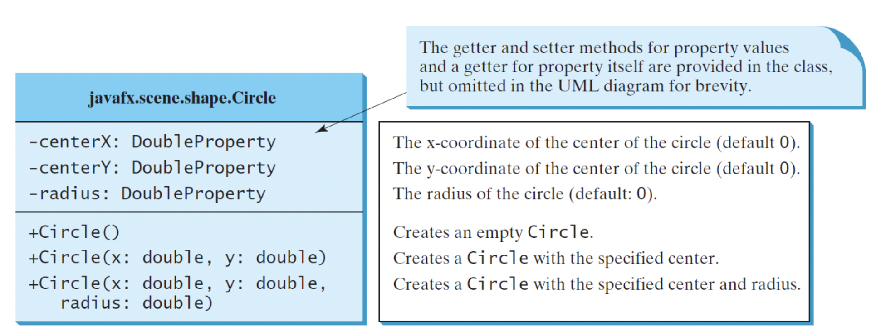
Circle
Let's examine Circle, its features and methods. A circle is defined by its parameters centerX, centerY, and radius.
The Circle class defines a circle.

Slide 70
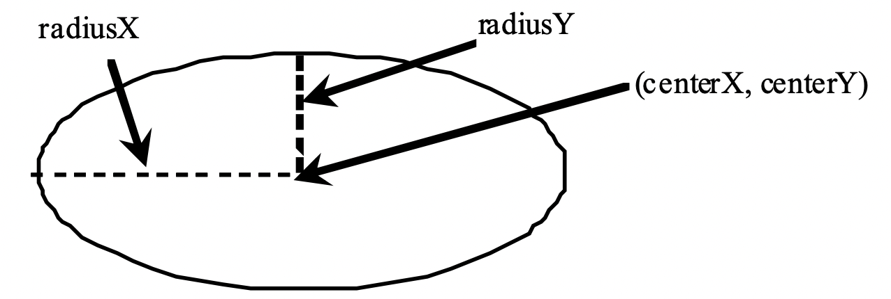
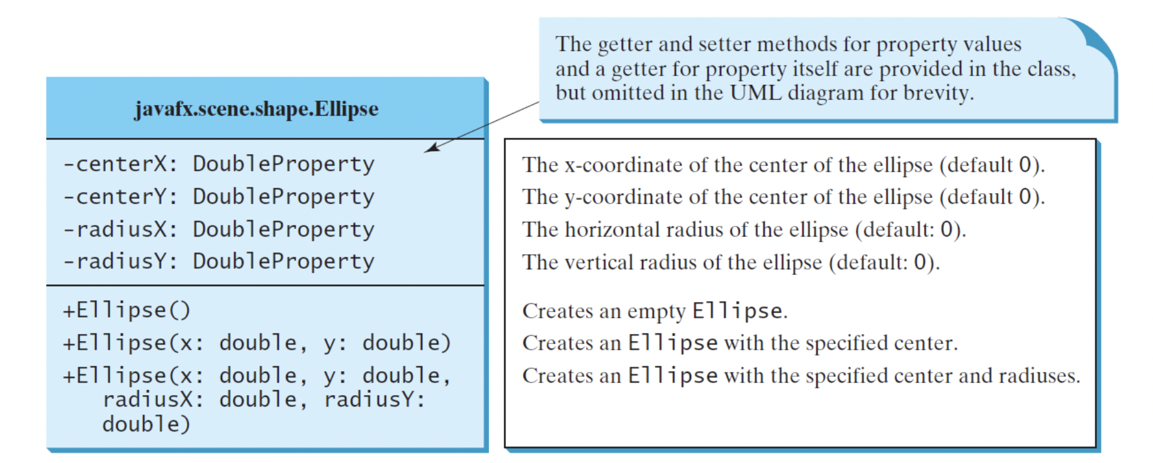
Ellipse
Let's examine the ellipse, its properties and methods.

Slide 71

Ellipse
package com.example.deneme5;
import javafx.application.Application;
import javafx.scene.Scene;
import javafx.scene.layout.Pane;
import javafx.scene.paint.Color;
import javafx.stage.Stage;
import javafx.scene.shape.Ellipse;
public class HelloApplication extends Application {
@Override // Override the start method in the Application class
public void start(Stage primaryStage) {
// Create a scene and place it in the stage
Scene scene = new Scene(new MyEllipse(), 300, 200);
primaryStage.setTitle("ShowEllipse"); // Set the stage title
primaryStage.setScene(scene); // Place the scene in the stage
primaryStage.show(); // Display the stage
}
/**
* The main method is only needed for the IDE with limited
* JavaFX support. Not needed for running from the command line.
*/
public static void main(String[] args) {
launch(args);
}
}
class MyEllipse extends Pane {
private void paint() {
getChildren().clear();
for (int i = 0; i < 16; i++) {
// Create an ellipse and add it to pane
Ellipse e1 = new Ellipse(getWidth() / 2, getHeight() / 2,
getWidth() / 2 - 50, getHeight() / 2 - 50);
e1.setStroke(Color.color(Math.random(), Math.random(),
Math.random()));
e1.setFill(Color.WHITE);
e1.setRotate(i * 180 / 16);
getChildren().add(e1);
}
}
@Override
public void setWidth(double width) {
super.setWidth(width);
paint();
}
@Override
public void setHeight(double height) {
super.setHeight(height);
paint();
}
}
ShowEllipse

Slide 72

Arc
Let's examine Arc, its properties and methods.

Slide 73

Arc
Arc, examples.

Slide 74

Arc
package com.example.deneme5;
import javafx.application.Application;
import javafx.scene.Scene;
import javafx.scene.Group;
import javafx.scene.layout.BorderPane;
import javafx.scene.paint.Color;
import javafx.stage.Stage;
import javafx.scene.shape.Arc;
import javafx.scene.shape.ArcType;
import javafx.scene.text.Text;
public class HelloApplication extends Application {
@Override // Override the start method in the Application class
public void start(Stage primaryStage) {
Arc arc1 = new Arc(150, 100, 80, 80, 30, 35); // Create an arc
arc1.setFill(Color.RED); // Set fill color
arc1.setType(ArcType.ROUND); // Set arc type
Arc arc2 = new Arc(150, 100, 80, 80, 30 + 90, 35);
arc2.setFill(Color.WHITE);
arc2.setType(ArcType.OPEN);
arc2.setStroke(Color.BLACK);
Arc arc3 = new Arc(150, 100, 80, 80, 30 + 180, 35);
arc3.setFill(Color.WHITE);
arc3.setType(ArcType.CHORD);
arc3.setStroke(Color.BLACK);
Arc arc4 = new Arc(150, 100, 80, 80, 30 + 270, 35);
arc4.setFill(Color.GREEN);
arc4.setType(ArcType.CHORD);
arc4.setStroke(Color.BLACK);
// Create a group and add nodes to the group
Group group = new Group();
group.getChildren().addAll(new Text(210, 40, "arc1: round"),
arc1, new Text(20, 40, "arc2: open"), arc2,
new Text(20, 170, "arc3: chord"), arc3,
new Text(210, 170, "arc4: chord"), arc4);
// Create a scene and place it in the stage
Scene scene = new Scene(new BorderPane(group), 300, 200);
primaryStage.setTitle("ShowArc"); // Set the stage title
primaryStage.setScene(scene); // Place the scene in the stage
primaryStage.show(); // Display the stage
}
/**
* The main method is only needed for the IDE with limited
* JavaFX support. Not needed for running from the command line.
*/
public static void main(String[] args) {
launch(args);
}
}
ShowArc

Slide 75


Polygon
Let's examine Polygon, its properties and methods.

Slide 76

Polygon
package com.example.deneme5;
import javafx.application.Application;
import javafx.collections.ObservableList;
import javafx.scene.Scene;
import javafx.scene.layout.Pane;
import javafx.scene.paint.Color;
import javafx.stage.Stage;
import javafx.scene.shape.Polygon;
public class HelloApplication extends Application {
@Override // Override the start method in the Application class
public void start(Stage primaryStage) {
// Create a scene and place it in the stage
Scene scene = new Scene(new MyPolygon(), 400, 400);
primaryStage.setTitle("ShowPolygon"); // Set the stage title
primaryStage.setScene(scene); // Place the scene in the stage
primaryStage.show(); // Display the stage
}
/**
* The main method is only needed for the IDE with limited
* JavaFX support. Not needed for running from the command line.
*/
public static void main(String[] args) {
launch(args);
}
}
class MyPolygon extends Pane {
private void paint() {
// Create a polygon and place polygon to pane
Polygon polygon = new Polygon();
polygon.setFill(Color.WHITE);
polygon.setStroke(Color.BLACK);
ObservableList<Double> list = polygon.getPoints();
double centerX = getWidth() / 2, centerY = getHeight() / 2;
double radius = Math.min(getWidth(), getHeight()) * 0.4;
// Add points to the polygon list
for (int i = 0; i < 6; i++) {
list.add(centerX + radius * Math.cos(2 * i * Math.PI / 6));
list.add(centerY - radius * Math.sin(2 * i * Math.PI / 6));
}
getChildren().clear(); // Clear pane
getChildren().add(polygon);
}
@Override
public void setWidth(double width) {
super.setWidth(width);
paint();
}
@Override
public void setHeight(double height) {
super.setHeight(height);
paint();
}
}
ShowPolygon

Slide 77

Case Study: The ClockPane Class
This case study develops a class that displays a clock on a pane.
javafx.scene.layout.Panel
The getter and setter methods for these data fields are provided in the class, but omitted in the UML diagram for brevity.
ClockPane
-hour: int
-minute: int
-second: int
The hour in the clock. The minute in the clock. The second in the clock.
Constructs a default clock for the current time. Constructs a clock with the specified time.
+ClockPane()
+ClockPane(hour: int, minute: int, second: int)
+setCurrentTime(): void
+setWidth(width: double): void
+setHeightTime(height: double): void
Sets hour, minute, and second for current time. Sets clock pane’s width and repaint the clock, Sets clock pane’s height and repaint the clock,
ClockPane

Slide 78



Use the ClockPane Class
DisplayClock
Run

Slide 79

Homework - 1
Work on your own sample shapes program.

Slide 80
Next Lecture
We will continue to the topic.

Slide 81
Programming Session
Java FX

Slide 82
Summary
As a result, this week we learned Java FX group, panes, ui controls and shapes.

